Slide 1
Caveats on Tomographic Images
Gillian R. Foulger, Giuliano F. Panza, Irina M. Artemieva, Ian D. Bastow, Fabio Cammarano, John R. Evans, Warren B. Hamilton, Bruce R. Julian, Michele Lustrino, Hans Thybo, Tatiana B. Yanovskaya
Durham Univ., U.K., Univ. Trieste, Italy, Earthquake Administration, Beijing, China, Univ. Copenhagen, Denmark, Imperial College, London, U.S. Geological Survey, U.S.A., Colorado School of Mines, U.S.A., Univ. degli Studi di Roma La Sapienza, Italy, Sankt-Petersburg State Univ., Russia

Slide 2
Caveats on Tomographic Images
Gillian R. Foulger, Giuliano F. Panza, Irina M. Artemieva, Ian D. Bastow, Fabio Cammarano, John R. Evans, Warren B. Hamilton, Bruce R. Julian, Michele Lustrino, Hans Thybo, Tatiana B. Yanovskaya
Terra Nova, 25, 259-281, 2013

Slide 3
Teleseismic Tomography
Structure outside the study volume cannot be ignored
Evans & Achauer (1993)

Slide 4
Teleseismic Tomography
Absolute velocities are not obtained
Evans & Achauer (1993)

Slide 5
Teleseismic Tomography
Variations in the vertical are not calculated
Evans & Achauer (1993)

Slide 6
Vertical Smearing
Eken et al. (2008)

Slide 7
Anomaly Amplitudes
Heavily dependent on inversion parameters
  Damping factors
  Model smoothness
  Parameterization of model
  Depth to base of block
  ± station corrections
  Crust used
Eken et al. (2008)

Slide 8
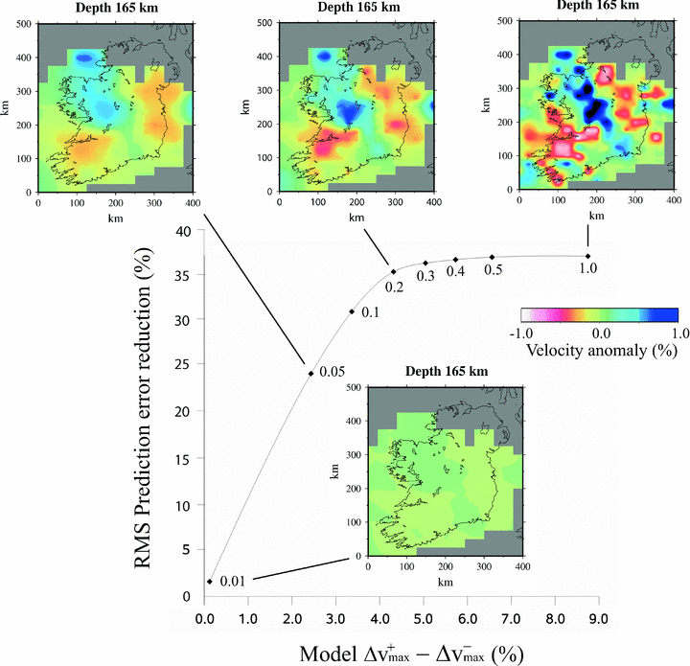
O’Donnell et al. (2011)
Notes:
Figure 5: Trade-off curve showing the balance between model roughness (quantified by the difference between the extremal positive and negative wave speed contrasts) and root mean square prediction error reduction (%). The curve is labeled with wave speed model parameter standard deviations. Each point represents a model solution corresponding to the indicated model parameter standard deviations (from O'Donnell et al., 2011).

Slide 9
Inhomogeneous Ray Coverage
(Figure provided by Jeroen Ritsema and published in Hamilton, 2011).
Notes:
Figure 7: S and SS raypaths sampling the mid-mantle. Much of Earth's interior is effectively unsampled, and much else is sampled primarily by sub-parallel rays rather than by the diversely crossing rays required for good tomographic imaging. The so-called deeply subducted “Farallon slab” (Grand et al., 1997) beneath the Caribbean and eastern United States is particularly non-uniformly sampled. Published tomographic images of this region vary greatly (Figure 11). (Figure provided by Jeroen Ritsema and published in Hamilton, 2011).

Slide 10
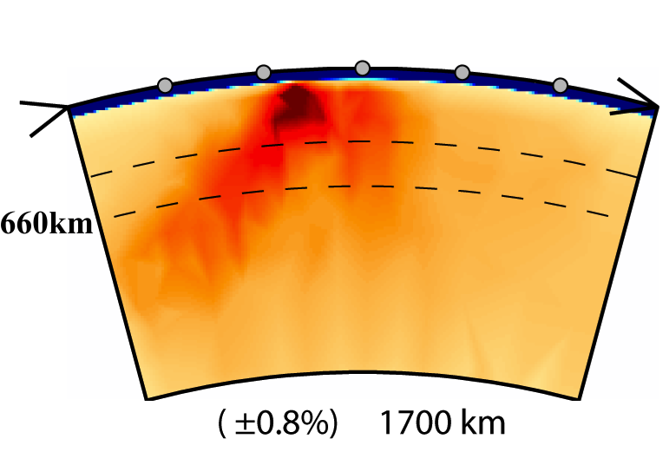
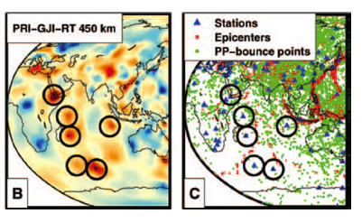
Inhomogeneous Ray Coverage
NW SE
NW SE
Wolfe et al. (2009)
Li et al. (2008)
Montelli et al. (2004; 2006)

Slide 11
Reference Models
Foulger et al. (2013)

Slide 12
Geochemistry
Assumptions about tomography lead to assumptions about geochemistry
Cannot be assumed:
  CMB “slab graveyard”
  “superplumes” are hot
No tomographic support for:
  High-³He/⁴He, radiogenic basalts from CMB

Slide 13
The Way Forward
  Publish seismic models on web, with errors
Integrate seismology & geochemistry where each has power:
  e.g., LVZ = depth where pargasitic amphibole unstable
  Suggests melt present

Slide 14
Caveats on Tomographic Images
Gillian R. Foulger, Giuliano F. Panza, Irina M. Artemieva, Ian D. Bastow, Fabio Cammarano, John R. Evans, Warren B. Hamilton, Bruce R. Julian, Michele Lustrino, Hans Thybo, Tatiana B. Yanovskaya
Terra Nova, 25, 259-281, 2013

