Slide 1
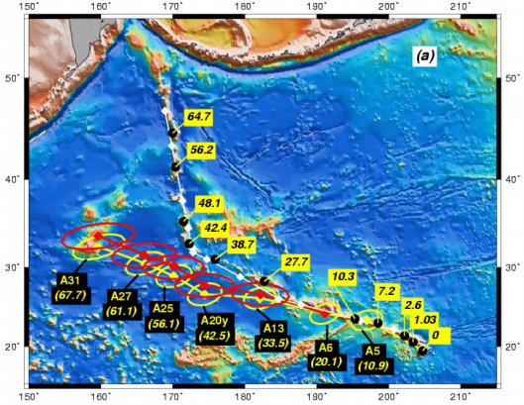
What the Hell is Hawaii?
George Baker
Louis Dyer
Timothy Emkes
Matthew Haythornthwaite
Cameron Lalley
Devon Platt
William Priest
Alistair Stewart
(Foulger, 2015)

Slide 2
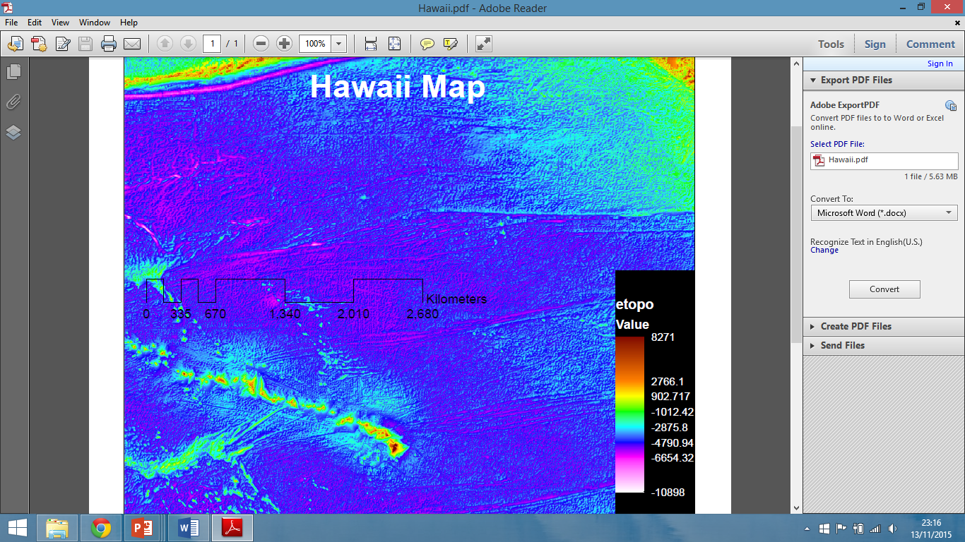
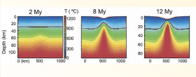
Bathymetry
Plate Hypothesis
Upwelling asthenosphere accompanying rifting/subsidence
Plume Hypothesis
Swell/Lithospheric Uplift
(Foulger, 2015)

Slide 3
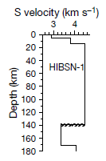
Shallow Velocity Structure
Study in an attempt to locate the depth of first partial melt
Absence of LVZ at low depths expected with the plate theory
Initiation of LVZ instead at 140km, potential depth of plume head?
Kind et al. (2000)
(Foulger, 2015)

Slide 4
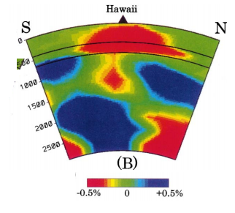
Deep Velocity Structure
660km discontinuity produces a temperature increase of 50 degrees, explaining the 0.5% decrease in velocity which produces the ‘plume like’ structure
Absence of a CMB anomaly
Zhao. (2001)

Slide 5
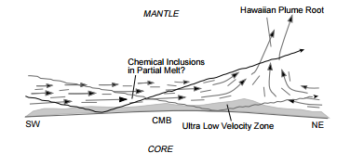
Deep Velocity Structure
Cartoon representing low velocity anomaly observed in shear wave seismic study
Russell et al. (1998)

Slide 6
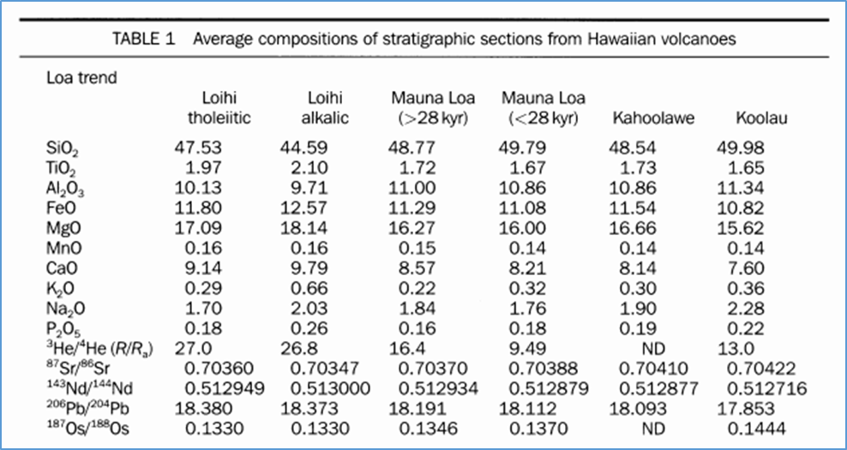
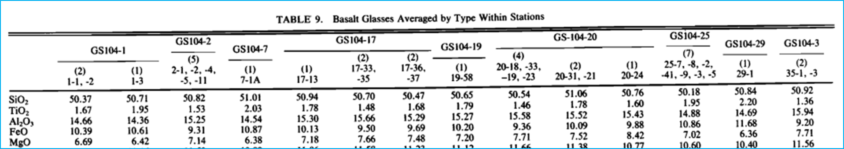
Major Element Variability
Ref: Major-element variability in the Hawaiian mantle plume, ERIK H. HAURI
Ref: Compositional Variation in Normal MORB From 22ø-25øN ß, Mid-Atlantic Ridge and Kane Fracture Zone, W. B. BRYAN
Hawaii Wt% (above left) - ~11% FeO , 17% MgO , 11% Al2O3
Mid-Atlantic Ridge Wt% (above right) - ~10% FeO , 7% MgO , 15% Al2O3
Composition of magma can create anomalies in seismic data
Temperature per 100 degree increase = 1% anomaly in P-wave velocity (G. Foulger lecture notes)
Composition (per 10% reduction in Mg/(Mg+Fe) in olivine) = 7% anomaly (G. Foulger lecture notes)
Quick summary: geochemical data indicates different magma sources, and anomalies used to prove presence of ‘hot’ plumes can be caused instead by magma composition

Slide 7
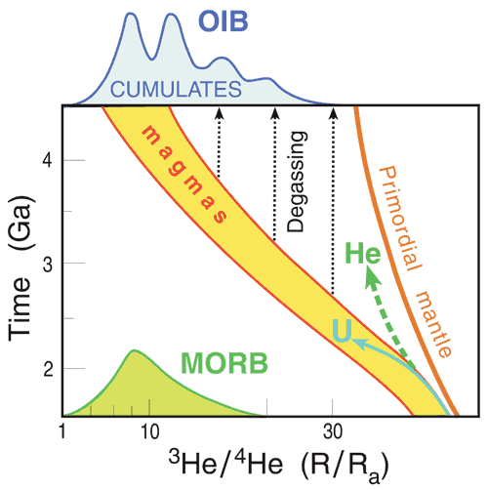
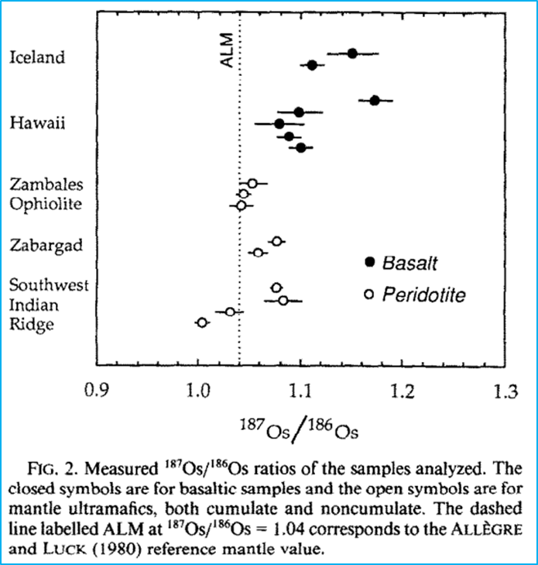
Geochemical isotope ratios as indicators of source
Ref: http://www.mantleplumes.org/HeliumFundamentals.html
Ref: Osmium isotopic characteristics of mantle-derived rocks
CANDACE E. MARTIN*
Primordial He3 found in abundance in lower mantle, so higher He3/He4 ratios could imply that a rock originated from a deep source.
MORB values = 8 +/- 2
OIB’s can have value of 20+
Hawaii = ~6
Interior of the Earth is chemically fractionated
If plumes originate at Core-Mantle Boundary then they should produce magmas enriched in heavier elements (e.g. Platinum Group Elements).

Slide 8
That’s more than enough for today!
(Yaoling, 2015)

