Slide 1
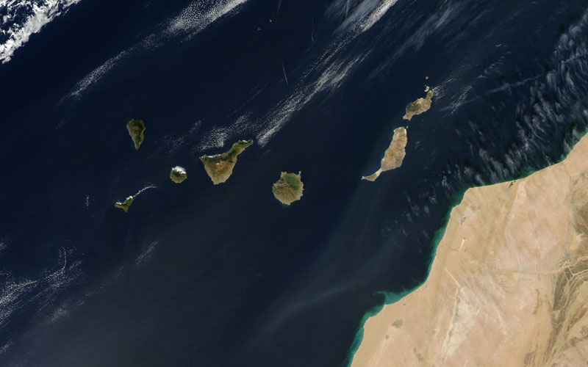
Canary Islands:
Plate or Plume?
Emily Hadrill, Marissa Lo, Libby Passey, Ally Sweeney, Ellie White
Notes:
Title slide
Canary Islands are an archipelago of seven big islands with multiple smaller islands
The Islands are located approximately 100km off the West coast of Morocco

Slide 2
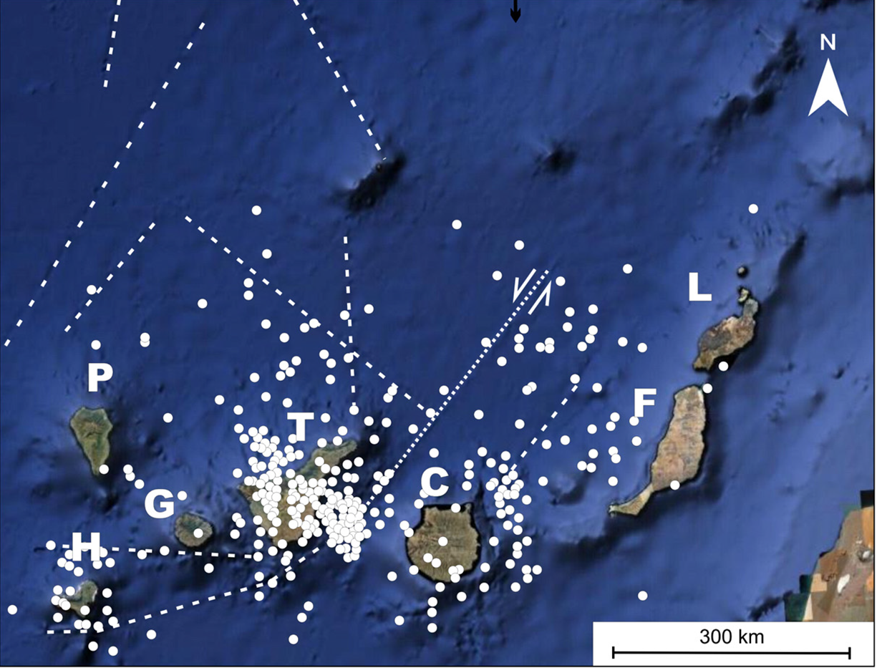
Introduction
Notes:
Introduction:
They are roughly in line with the trend of the Atlas Mountains of North Africa
Background from Geyer and Marti (2010)
The geometry of the microplates beneath the Canaries is not certain – the Canaries lie above the Moroccan microplate (to the south of the image) and the Iberian microplate (to the north of the image). The dotted white lines show the “presumed plate boundaries”.

Slide 3
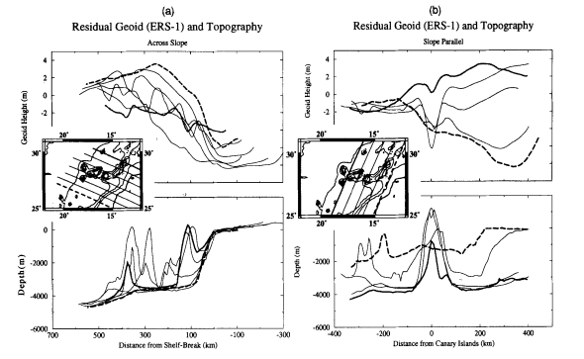
Precursors and Onset of Activity
There is uplift in the region of the Islands(A.B. Watts, 1996) (A. Hildenbrand, 2003)
Erosional unloading responsible for uplift? (I. Mendez et al, 2008)
No broad topographic swell – narrow plume? (A.B. Watts, 1994)
Figure 1: Profiles of the geoid anomalies and topography. (A.B. Watts, 1994)
Notes:
Ally – precursors and onset of activity
There is uplift in the region of the Islands, greater than 1.5km in Fuerteventura and Lanzarote and at a constant rate of ~0.5mm/yr in La Palma– If the plate hypothesis was true you would not expect uplift.
There is a suggestion that the uplift is a result of erosional unloading, however I. Menendez et al have calculated that this alone cannot explain the full recorded uplift – the rest due to plume?
But as you can see there is no deformation over the broader area as you would expect of a mantle plume. The A.B. Watts suggests that this is because the plume is narrow and the oceanic lithosphere is strong enough not to deform over the wider area.

Slide 4
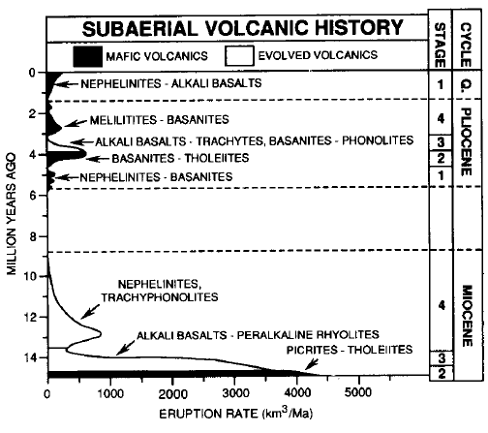
Time History of Volcanism
As seen on Figure, there have been 3 volcanic cycles:
Miocene (shield volcanism)
Pliocene (1st rejuvenated)
Quaternary (2nd rejuvenation)
Intermittent eruptions
Anaga, northern Tenerife, sees a large difference in rock ages from slope to slope (Ancochea et al 1990)
Picrite was an early eruption product
Larger volume at start but not enough to be classed as a flood basalt
Figure 2:
Eruption rate versus age for the 3 volcanic cycles
(Hoernle, Tilton, and Schmincke (1991))
Notes:
Marissa – time history of volcanism
Numerous sources have defined 3 volcanic cycles in the Canaries’ history
The figure shows 3 key points: firstly, that the eruptive history is intermittent. This is backed up by potassium-argon dating of rocks in different regions of Tenerife. The northern slope of the Anaga Peninsula are dated at 15.7Ma, whereas the southern slope is dated at 4.65Ma. PLATE!
Secondly, the composition of the eruptives is shown. As you can see picrite (define picrite?) is an early eruptive product – PLUME!
Thirdly, whilst the volcanism is onset with a relatively large volume compared to the rest of the volcanic history, 4000 km^3 Ma^-1 is not a large enough volume to be considered a flood basalt. A flood basalt would be 0.1km^3 per year, compared to 0.004km^3 per year for the Canaries – NOT PLUME!

Slide 5
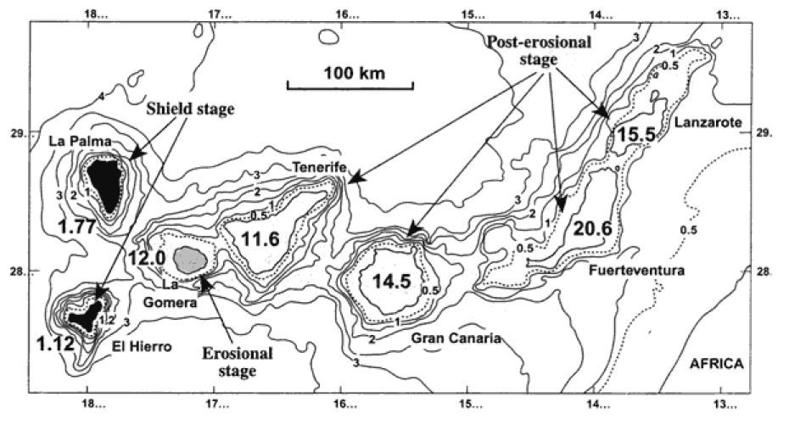
Time History of Volcanism
Figure 3:
Geographical map showing ages of the different Canary Islands in million years.
(Carrecado et al (2002)
Age of volcanism decreases to the West in a time-progressive chain.
Notes:
Marissa – time history of volcanism
The age of volcanism decreases to West forming a time progressive chain, although its not perfect.
This age progression has been supported in a paper by Carmen Martinez-Arevalo by radioisotropic measurements from the oldest exposed volcanic rocks on each island.

Slide 6
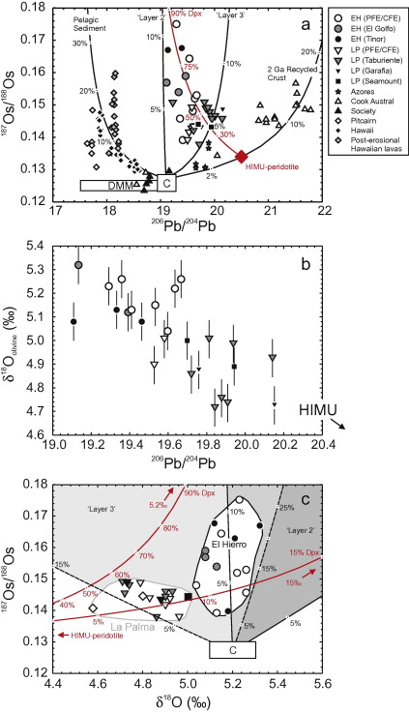
Chemical and Temperature Anomalies
Figure 5: Mixing curves between common mantle component and recycled oceanic crust and sediments. (Day et al., 2010)
Figure 4. Trace elements in the shield stage lavas on Canary Islands. (Gurrenko et al. 2006)
Possible positive temperature anomaly in the mantle.
Recycled crust and lithosphere in mantle source.
HIMU source
Notes:
There is a sub-lithospheric seismic anomaly beneath the islands. Temperature anomalies have been modelled to try and reproduce this. 1335 degrees was used as the average mantle temperature to measure anomalies from. Only an anomaly of 100 degrees or more could explain the observed anomalies. This supports the plume hypothesis and falsifies the plate. But with a plume we would expect greater positive anomalies of 200-300 degrees.
The left figure shows the relative depletion of potassium and lead which is common in HIMU-type rocks. Gurenko agrees that the Canary magamas are formed from partial melting of HIMU- type rocks containing recycled oceanic lithosphere and sediments younger than 2 billion years.
The right figure shows that the magmas were formed from mixing.
The contamination in canary magmas is unlikely to come from crustal depths, falsifying the plate hypothesis.
Geochemistry cannot tell us about the depth of these isotopically distinct mantle reservoirs.
Overall, I don’t think that chemical anomalies can give strong enough evidence to effectively falsify either hypothesis.

Slide 7
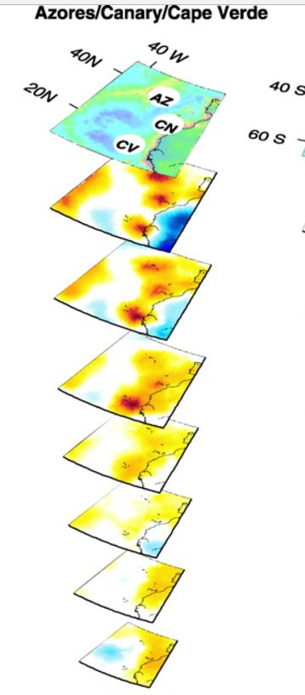
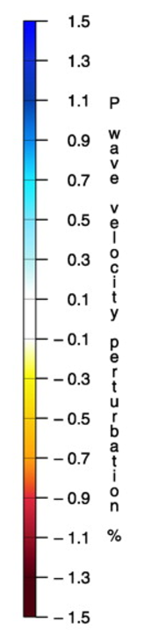
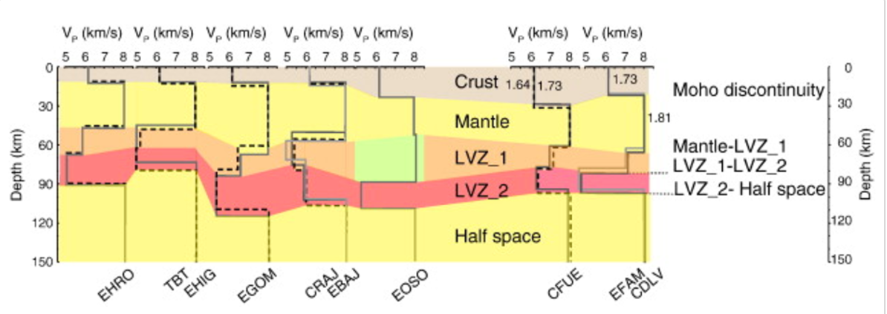
Mantle Structure Beneath Islands
No evidence of Eastward flux flow (Martinez-Arevalo et al)
Evidence for thinning of transition zone?
Figure 6: Vp models of the shallow Earth structure produced with forward modelling at 0.5 Hz (Martinez-Arevalo et al, 2013)
Figure 7: 3D tomographic view of proposed plume beneath the Canary Islands (Montelli et al. 2004)
Notes:
Libby and Ellie – mantle structure
The tomographic image from Montelli et all 2004 shows a 400km wide plume that extends 1450km down where is merges with the Azores plumes.
Martinex- Arevalo presents evidence to suggest that a plume does not appear to be present under the study region, and nor is there eastward flow of buoyant material from a source in the central Atlantic.
A plume would show evidence of localised convection. Figure 6 shows crustal thinning to the west. We can observe the trend of lithospheric thinning contrary to a flux towards East, as is proposed in some genesis models.
Found the transition zone structure is normal which indicates that there are no upper mantle thermal perturbations you would expect for a mantle plume and the structures in the study suggest that a common process acts to promote local melting or deliver melts from a distant source.

Slide 8
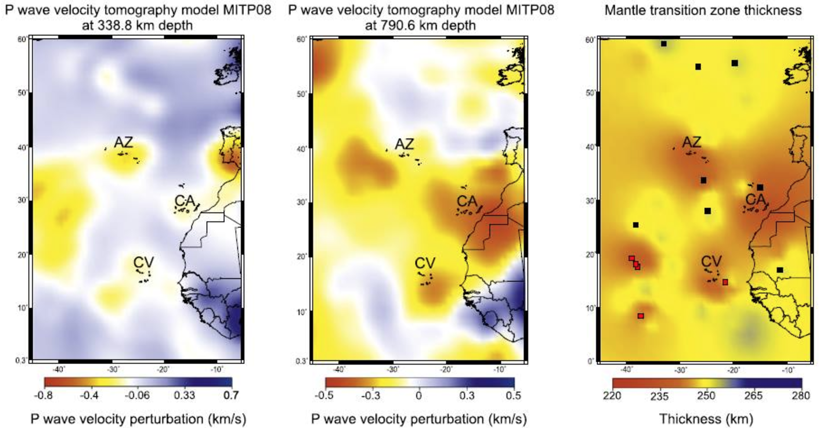
Mantle Structure Beneath Islands
Figure 8:
D,e) 2D slices through P wave velocity tomography model.
f) Mantle transition zone (MTZ) thickness, red indicates thinner than average MTZ. Saki et al. 2015
Notes:
Martinez says that a plume would be indicated by a TZ thinning of about 30km, which we can see in this figure, however Martinez finds in their study that thinning is not significant. The image from the Saki paper for thickness has been resolved from seismic data with a limited resolution, as indicated by the scale bar on the second image in this figure.
This paper suggests that there is a large area of upwelling that reaches the lower boundary of the transition zone but does not penetrate this, but three narrow plume do which create the three island hot spots. This is contradictory to Montelli’s studies which suggest that the narrow plumes extend much further down (1450km) before they merge.

Slide 9
Conclusions
 | Plate Hypothesis | Plume Hypothesis
Confidently falsifies | Picrite as an early-eruptive product Some tomographic images show a low-velocity zone extending 1400km deep | Intermittent eruptions rather than continuous Crustal thinning in wrong direction
Possibly falsifies | - Resolution of tomographic images questionable for 3-pronged plume | - While there is uplift (which would falsify plate) but its not in the broad swell you would expect
Notes:
falsify plate: picrite is an early eruptive product, tomographically too deep for plate, 3-fingered plume possibly seen but resolution of tomographic images questionable, uplift
falsify plume: no broad topographic swell, intermittent eruptions rather than continuous, thinning in wrong direction

Slide 10
References
Abdel-Monem A., Watkins N.D., and Gast P.W.. (1972). Potassium-argon ages, volcanic stratigraphy, and geomagnetic polarity history of the Canary Islands: Tenerife, La Palma, and Hierro. American Journal of Science. 272; 805-825.
Ancochea E. et al. (1990). Volcanic evolution of the island of Tenerife (Canary Islands) in the light of new K-Ar data. Journal of Volcanology and Geothermal Research. 44; 231-249
Anderson, D. L. (2000). The thermal state of the upper mantle; No role for mantle plumes. Geophysical Research Letters, 3623–3626.
Day, J. M., Pearson, G., Macpherson, C. G., Lowry, D., & Carracedo, J. C. (2010). Evidence for distinct proportions of subducted oceanic crust and lithosphere in HIMU-type mantle beneath El Hierro and La Palma, Canary Islands. Geochimica et Cosmochimica Acta, 6565-6589.
Fullea et al, J. (2015). The Canary Islands hot spot: New insights from 3D coupled geophysical–petrological modelling of the lithosphere and uppermost mantle. Earth and Planetary Science Letters, 71-88.
Geyer A and Martí J. (2010). The distribution of basaltic volcanism on Tenerife, Canary Islands: Implications on the origin and dynamics of the rift systems. Tectonophysics. 483; 310–326
Gurenko, A. A., Hoernle, K. A., Hauff, F., Schmincke, H. U., Han, D., Miura, Y. N., & Kaneoka, I. (2006). Major, trace element and Nd–Sr–Pb–O–He–Ar isotope signatures of shield stage lavas from the central and western Canary Islands: Insights into mantle and crustal processes. Chemical Geology, 75-112.
Hildenbrand, A., Gillot, P., Soler, V. and Lahitte, P. (2003). Evidence for a persistent uplifting of La Palma (Canary Islands), inferred from morphological and radiometric data. Earth and Planetary Science Letters, 210(1-2), pp.277-289.
Hoernle K., Tilton G., and Schmincke H-U. (1991). Sr-Nd-Pb isotopic evolution of Gran Canaria: evidence for shallow enriched mantle beneath the Canary Islands. Earth and Planetary Science Letters. 106; 44-63.
José Mangas Viñuela. (2007). The Canary Islands Hot Spot. Available: http://www.mantleplumes.org/Canary.html. [Last accessed 04/11/2016.]
Menéndez, I., Silva, P., Martín-Betancor, M., Pérez-Torrado, F., Guillou, H. and Scaillet, S. (2008). Fluvial dissection, isostatic uplift, and geomorphological evolution of volcanic islands (Gran Canaria, Canary Islands, Spain). Geomorphology, 102(1), pp.189-203.
Menéndez, I., Silva, P., Martín-Betancor, M., Pérez-Torrado, F., Guillou, H. and Scaillet, S. (2008). Fluvial dissection, isostatic uplift, and geomorphological evolution of volcanic islands (Gran Canaria, Canary Islands, Spain). Geomorphology, 102(1), pp.189-203.
Notes:
References

