Slide 1
Plates vs. Plumes: A Geological Controversy
Gillian R. Foulger
Durham University, U.K.

Slide 2
Caveats on Tomographic Images
Gillian R. Foulger, Giuliano F. Panza, Irina M. Artemieva, Ian D. Bastow, Fabio Cammarano, John R. Evans, Warren B. Hamilton, Bruce R. Julian, Michele Lustrino, Hans Thybo, Tatiana B. Yanovskaya
Terra Nova, 25, 259-281, 2013

Slide 3
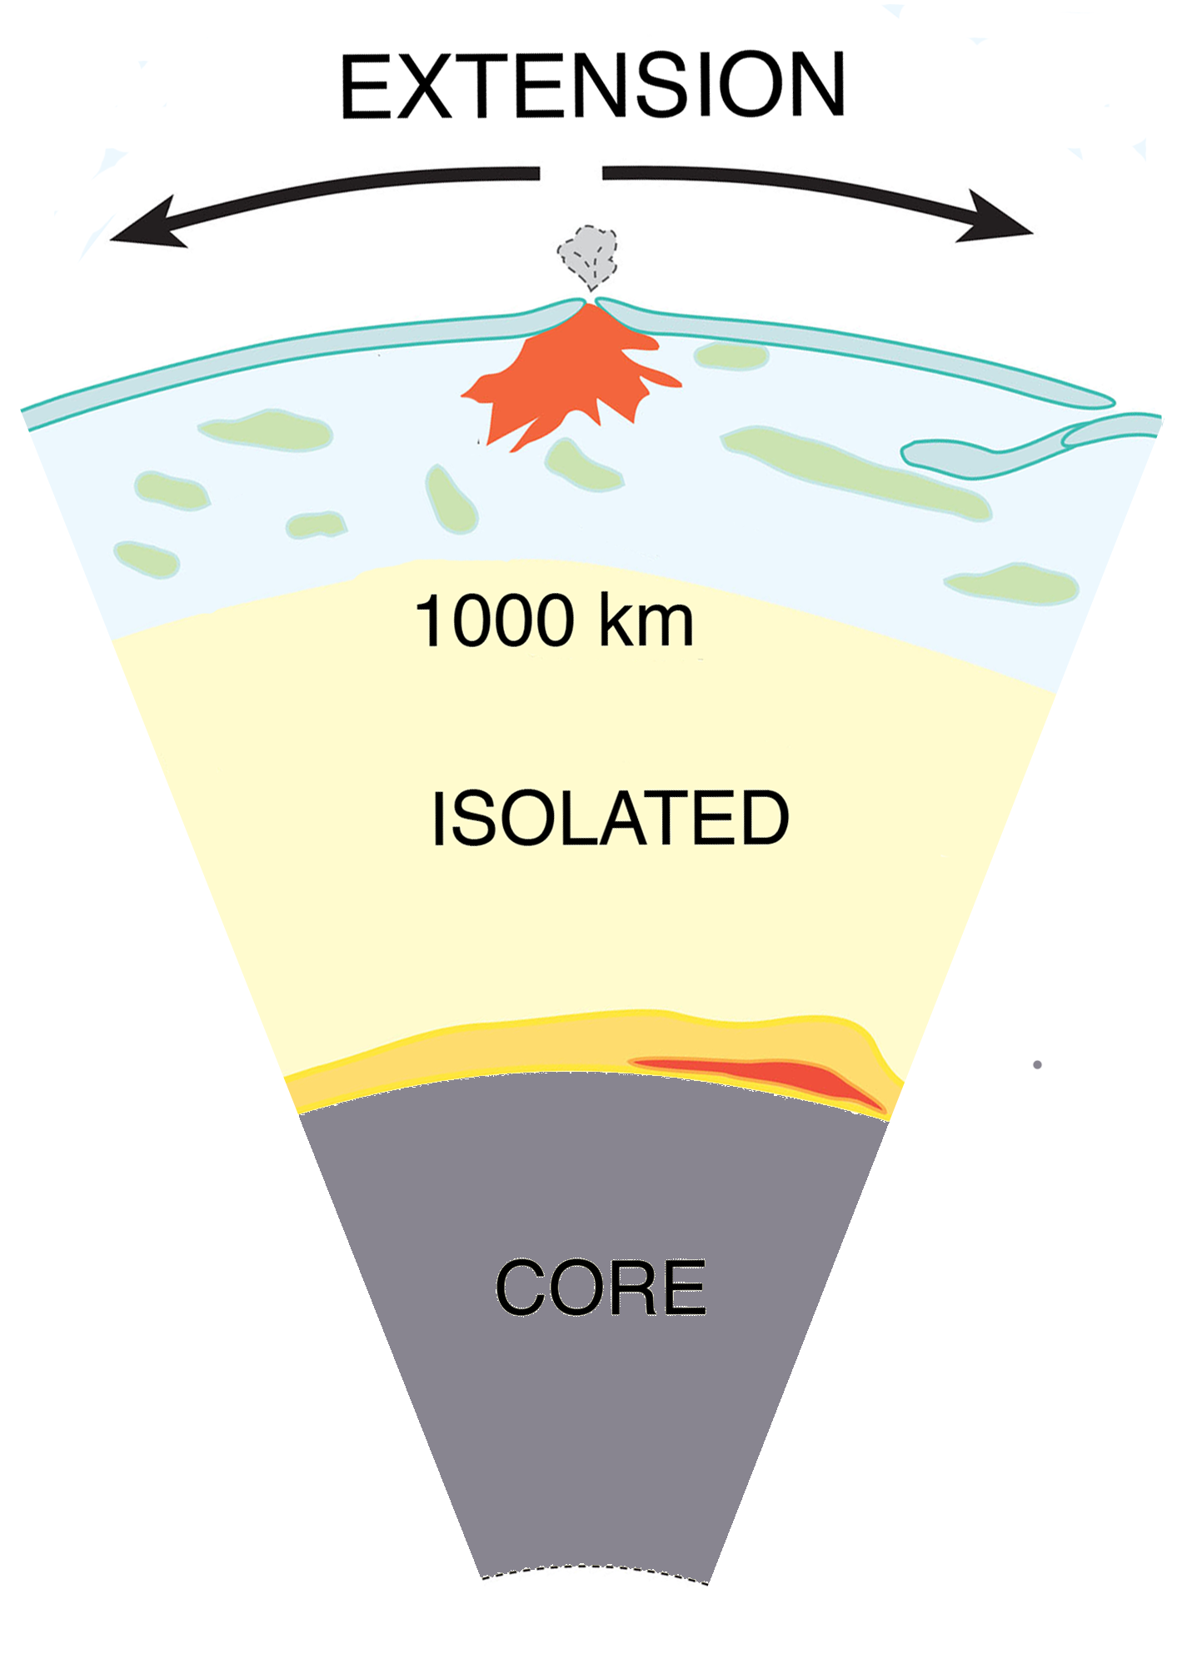
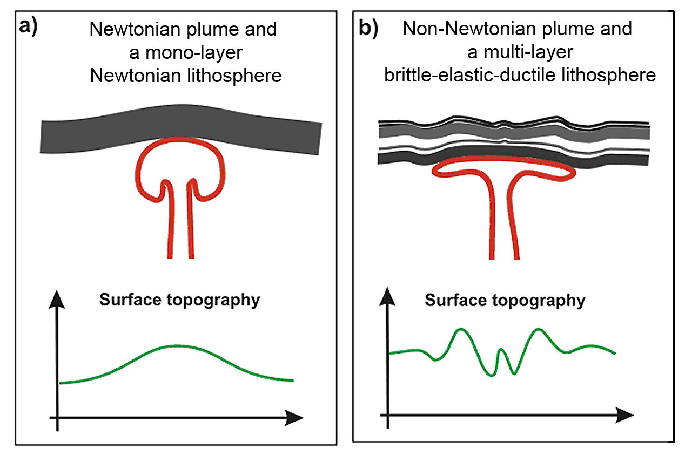
Top Down vs. Bottom Up

Slide 4
Teleseismic Tomography
Structure outside the study volume cannot be ignored
Evans & Achauer (1993)

Slide 5
Teleseismic Tomography
Absolute velocities are not obtained
Evans & Achauer (1993)

Slide 6
Teleseismic Tomography
Variations in the vertical are not calculated
Evans & Achauer (1993)

Slide 7
Vertical Smearing
Eken et al. (2008)

Slide 8
Anomaly Amplitudes
Heavily dependent on inversion parameters
  Damping factors
  Model smoothness
  Parameterization of model
  Depth to base of block
  ± station corrections
  Crust used
Eken et al. (2008)

Slide 9
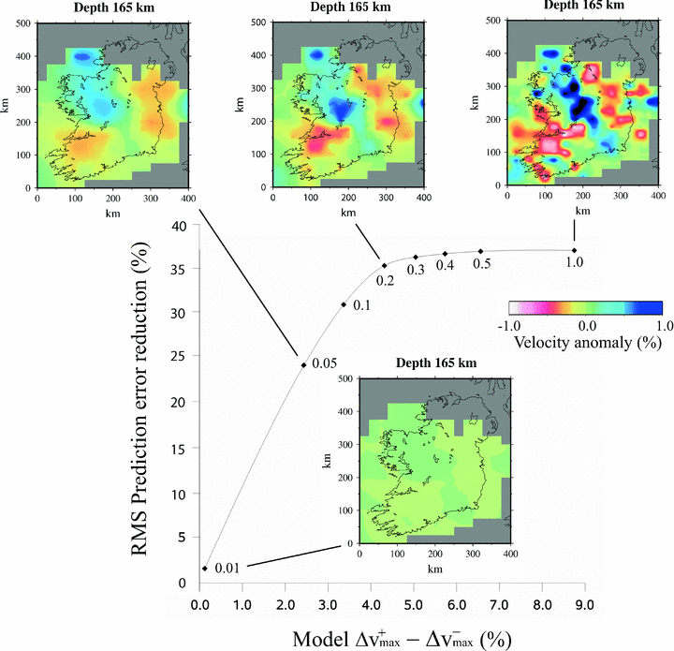
O’Donnell et al. (2011)
Notes:
Figure 5: Trade-off curve showing the balance between model roughness (quantified by the difference between the extremal positive and negative wave speed contrasts) and root mean square prediction error reduction (%). The curve is labeled with wave speed model parameter standard deviations. Each point represents a model solution corresponding to the indicated model parameter standard deviations from O'Donnell et al., 2011).

Slide 10
Inhomogeneous Ray Coverage
(Figure provided by Jeroen Ritsema, from Hamilton, 2011).
Notes:
Figure 7: S and SS raypaths sampling the mid-mantle. Much of Earth's interior is effectively unsampled, and much else is sampled primarily by sub-parallel rays rather than by the diversely crossing rays required for good tomographic imaging. The so-called deeply subducted “Farallon slab” (Grand et al., 1997) beneath the Caribbean and eastern United States is particularly non-uniformly sampled. Published tomographic images of this region vary greatly (Figure 11). (Figure provided by Jeroen Ritsema and published in Hamilton, 2011).

Slide 11
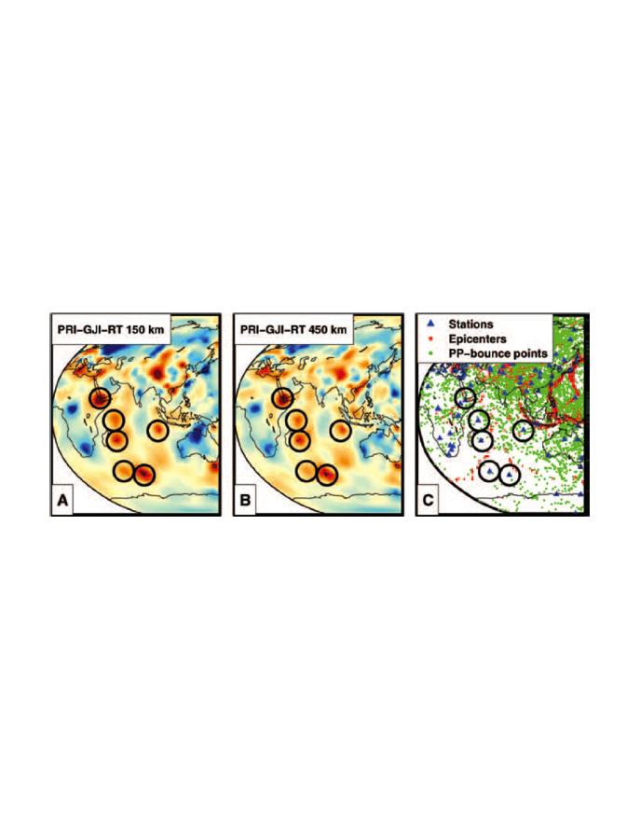
Inhomogeneous Ray Coverage
Montelli et al. (2004; 2006)

Slide 12
Inhomogeneous Ray Coverage
Montelli et al. (2004; 2006)

Slide 13
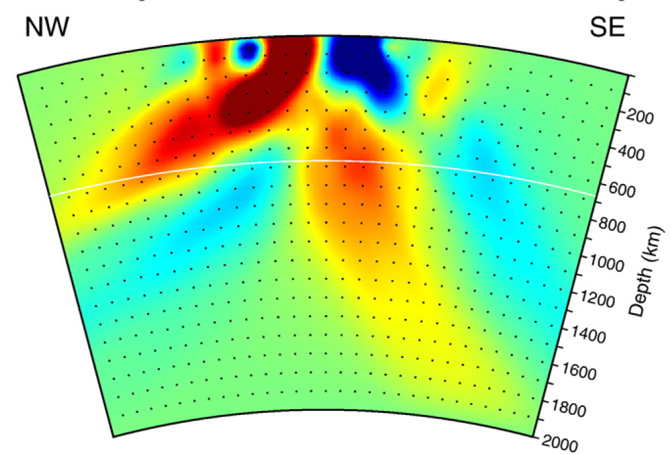
Inhomogeneous Ray Coverage:
Hawaii
V_{P}
Wolfe et al. (2001)

Slide 14
Retrieval of true structure
Foulger et al. (2013)

Slide 15
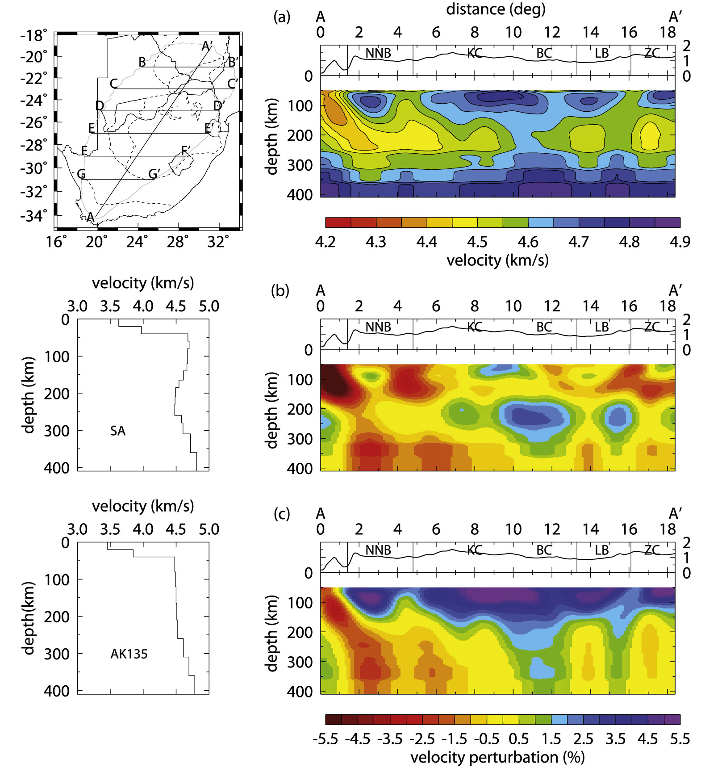
Display:
What is the correct
reference model?

Slide 16
Repeatability

Slide 17
Hawaii

Slide 18
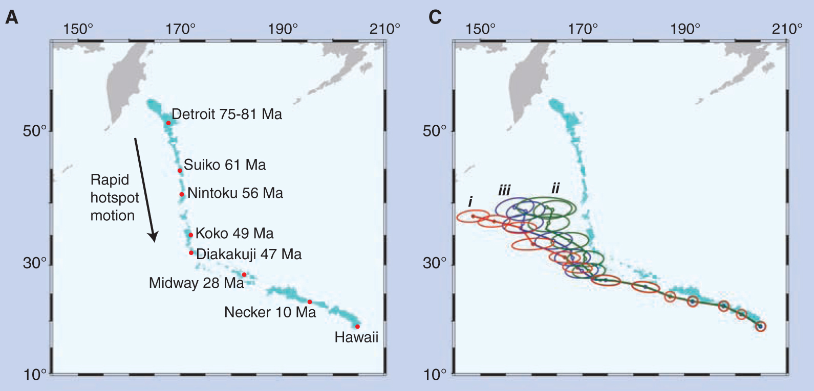
From Tarduno et al. (2009)

Slide 19
From Tarduno et al. (2009)

Slide 20
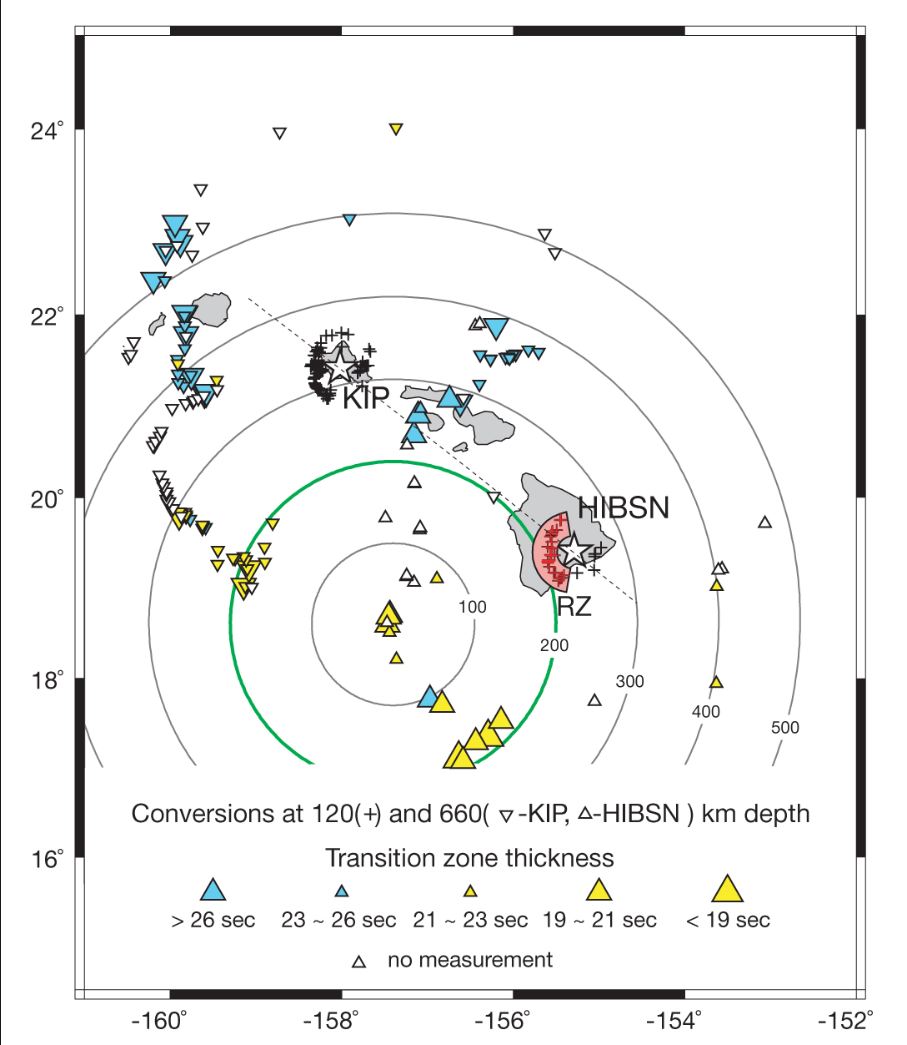
Hawaii: Receiver functions
From Li et al. (2000)

Slide 21
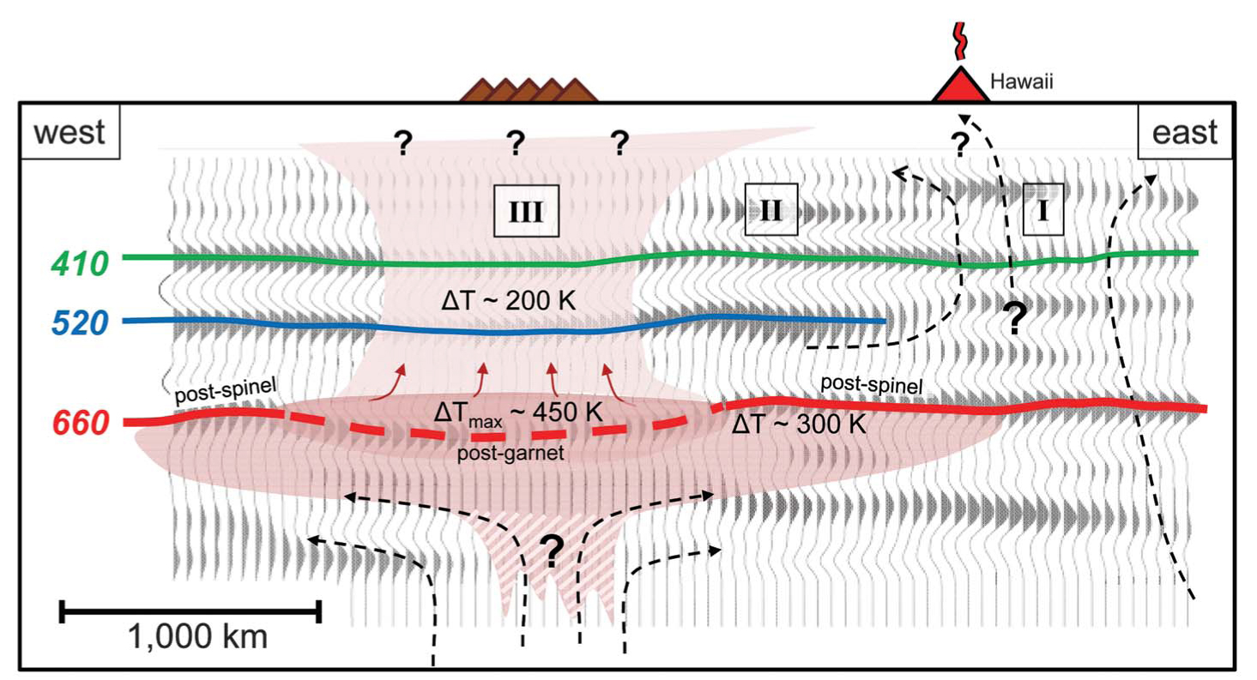
Hawaii: Receiver functions
2000 km
W
E
Cao et al. (2011)
Notes:
NOTE: The claim made during my talk that this paper had been withdrawn was incorrect, according to Prof. Rob van der Hilst, the 2nd author, whom I contacted afterwards.

Slide 22
Hawaii: Teleseismic tomography
NW SE
V_{S}
V_{P}
Wolfe et al. (2009)
S-wave tomography
P-wave tomography
Wolfe et al. (2001)

Slide 23
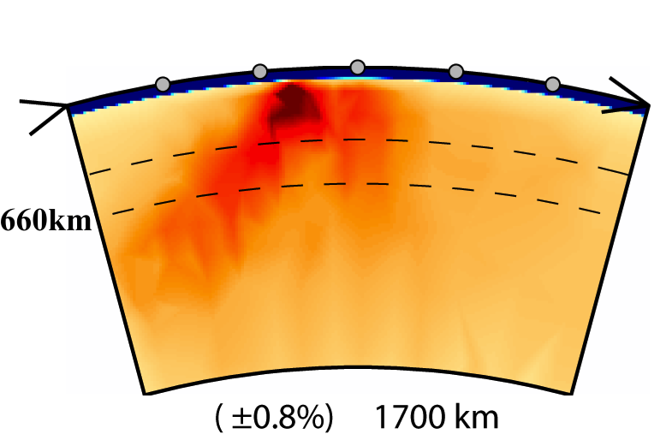
Hawaii: Tomography
NW SE
NW SE
Li et al. (2008)
Wolfe et al. (2009)

Slide 24
Bruce map
Notes:
NOTE: The claim that

Slide 25
Yellowstone

Slide 26
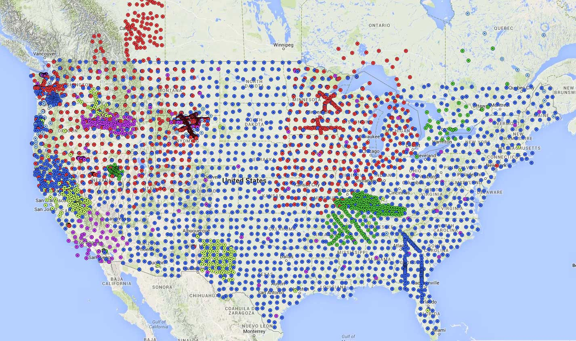
USArray network

Slide 27
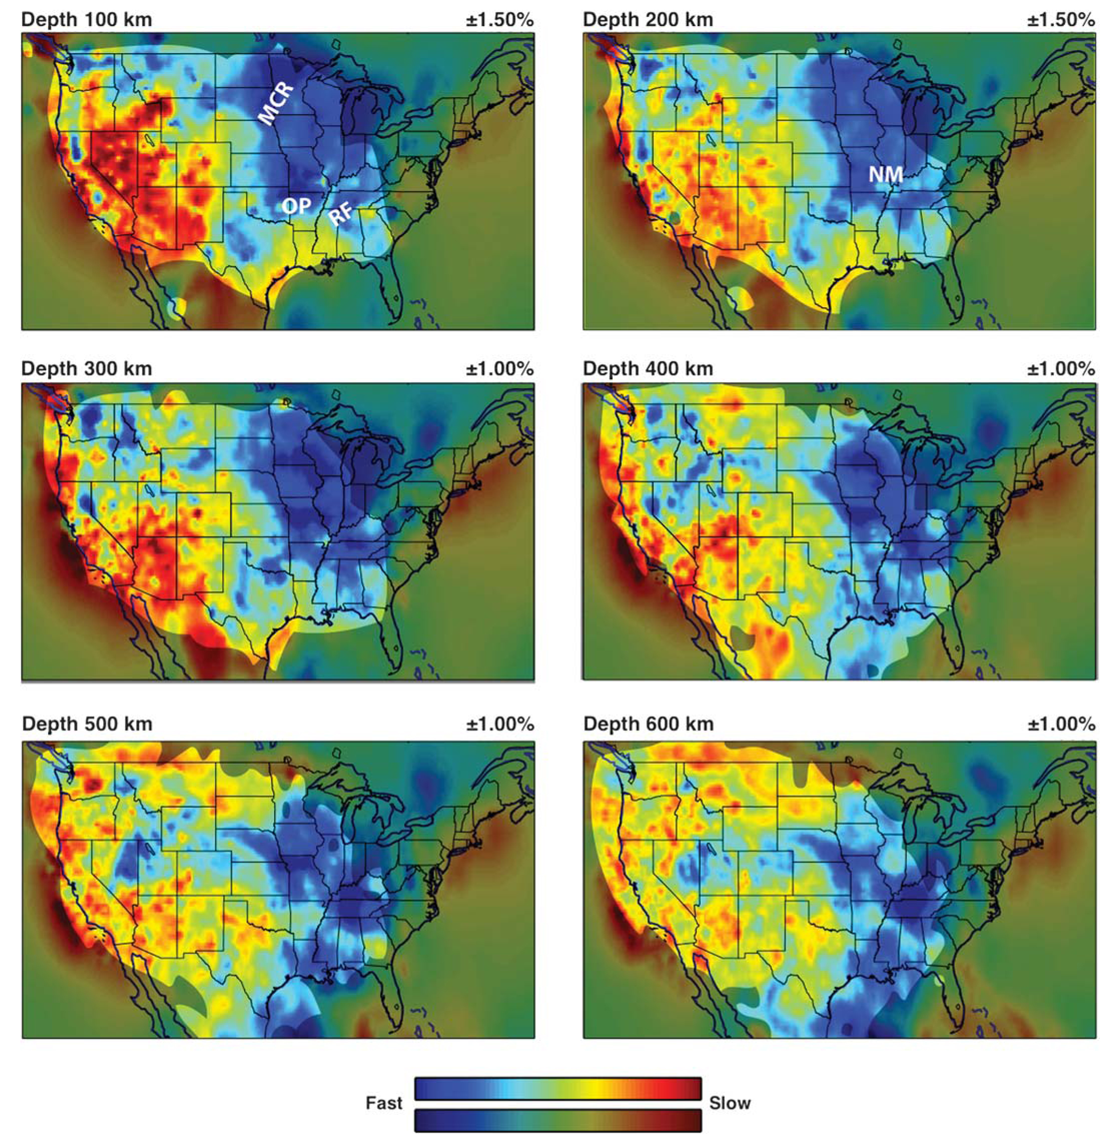
Burdick et al. (2014)

Slide 28
Yellowstone receiver function results

Slide 29
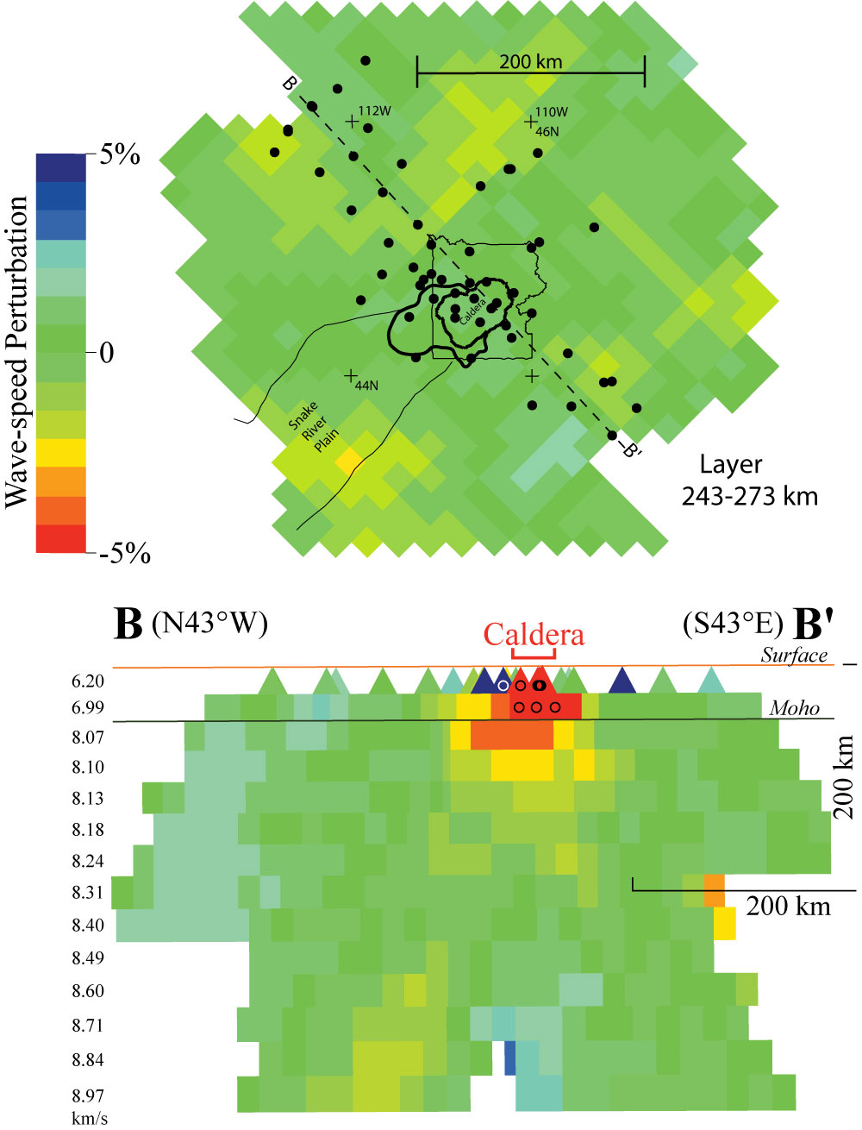
Yellowstone: Teleseismic tomography
Christiansen et al. 2002

Slide 30
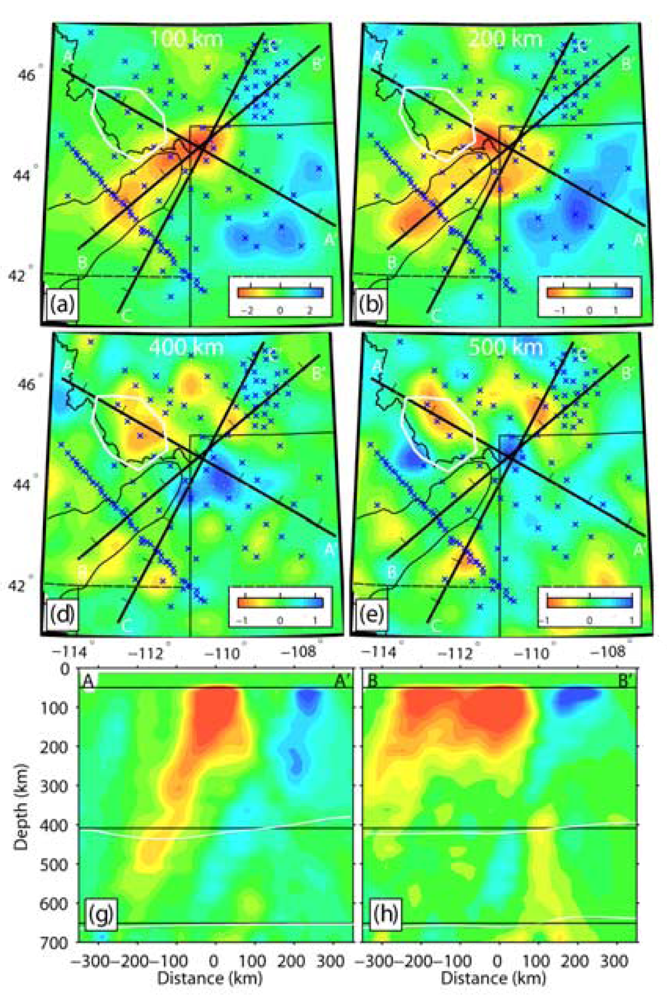
Yellowstone:
Teleseismic tomography
Yuan & Dueker (2005)

Slide 31
Yellowstone: Teleseismic tomography
Christiansen et al. 2002

Slide 32
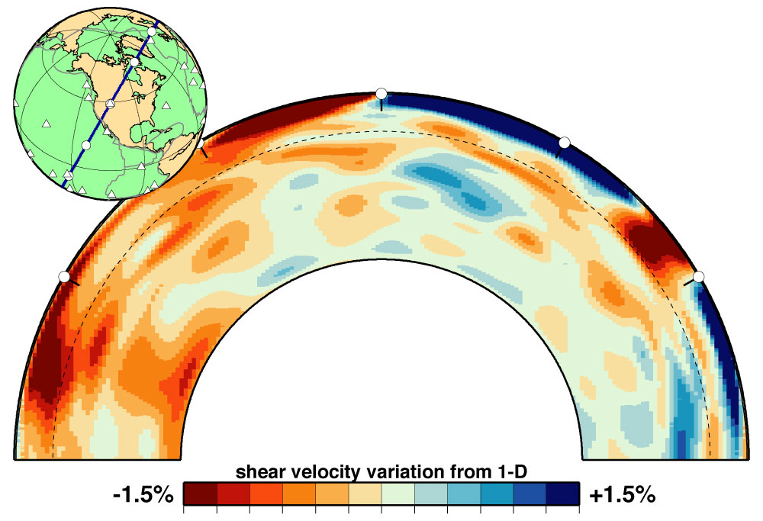
Yellowstone

Slide 33
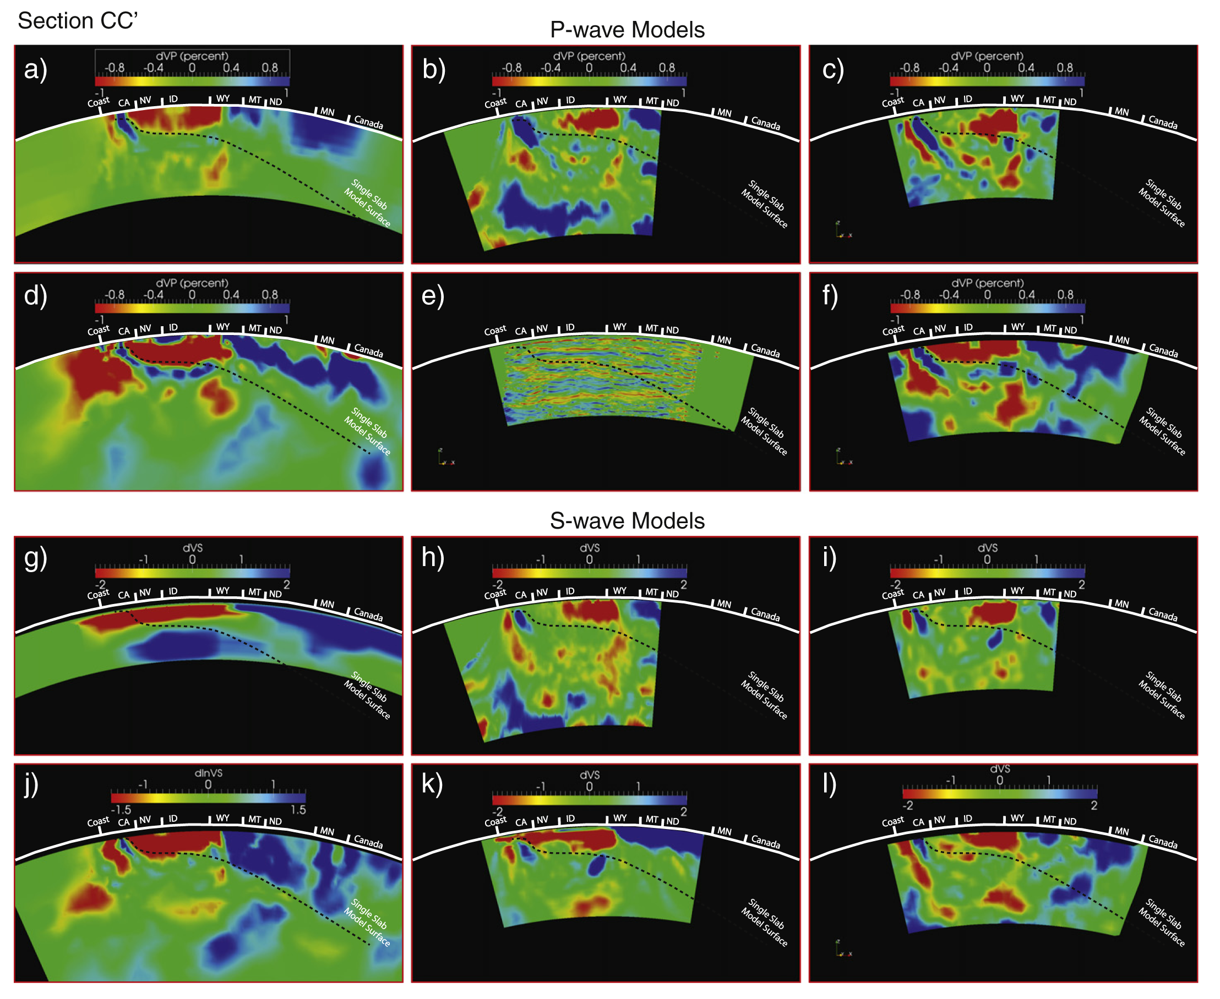
Pavlis et al. (2012)

Slide 34
Yellowstone tomography results
Imbricated, discontinuous pair of low-V bodies 500 and 1,000 km thick (Tian et al., 2009)
Discontinuous low-V in upper mantle (Schmandt & Humphreys, 2010)
Low-V_{P} to NW, bottoming a 500 km, not seen in V_{S} (Xue & Allen, 2010)
Corkscrew-shaped “whole-mantle plume” “bottoming at 900 km depth” (Obrebski et al., 2010)
Convoluted sub-vertical NE-orientated sheet 450 km long (James et al., 2011)
Low-V down to 1,000 km depth (Tian & Zhao, 2012)

Slide 35
Conclusions
  Seismic tomography seems unable to resolve the “plumes debate”
  Publish seismic models on web
    with errors
    in a standard form
    with an easy-to-use plotting tool
Integrate seismology & geochemistry
  where possible only
  e.g., LVZ = depth where pargasitic amphibole unstable
  suggests melt present

Slide 36
Caveats on Tomographic Images
END
Gillian R. Foulger, Giuliano F. Panza, Irina M. Artemieva, Ian D. Bastow, Fabio Cammarano, John R. Evans, Warren B. Hamilton, Bruce R. Julian, Michele Lustrino, Hans Thybo, Tatiana B. Yanovskaya
Terra Nova, 25, 259-281, 2013

