Slide 1
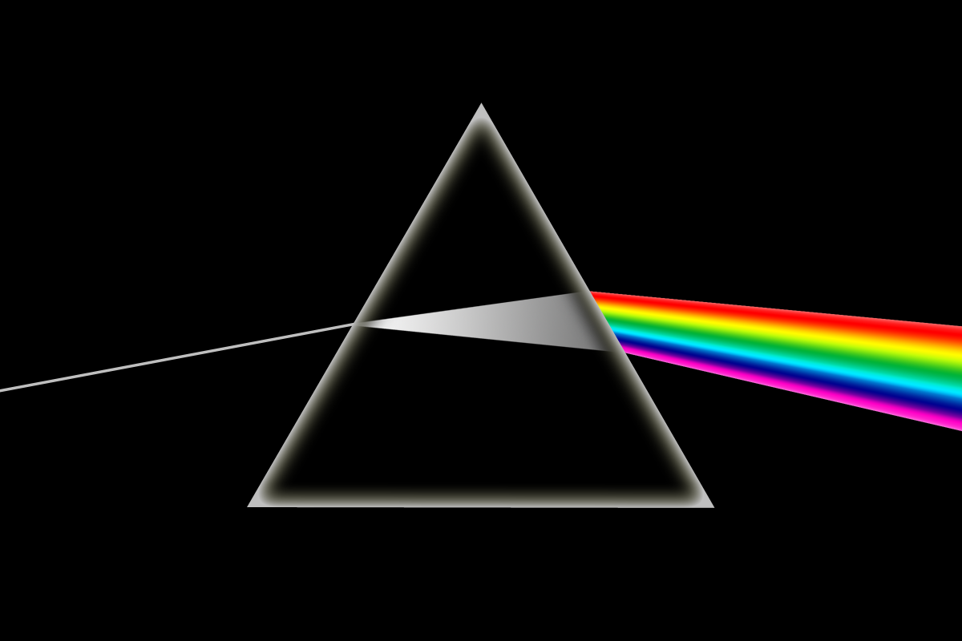
The dark side of plumes

Slide 2
Attention Plumers:
!
This is an
Anti-Plume Talk!

Slide 3
The mantle plume concept is 54 years old.
2017
Morgan, 1971
Wilson, 1963
Hofmann and Hart, 1982
>Seventy variants of Mantle Plumes
Griffiths and Campbell, 1990

Slide 4


Too many shades of plumes…
Thermal (1); Fossil (2); Channelled (3); Toroidal (4); Tabular (5); Depleted Residual (6); Finger-like (7); Recycled (8); Edge (9); Cold (10); Cacto- (11); Super (12); Asthenospheric (13); Dying (14); Not very energetic (15); Spaghetti (16); Baby (17); Head-free (18); Splash (19); Pulsating (20); Subduction fluid-fluxed Refractory (21); Hydrogen (22); Heterogeneous (23); Flattened Onion (24); Subduction-driving (25); Subduction-triggered (26); Washboard (27); Bent-shaped (28); Failing (29); Delamination-triggering (30); Concentrically-zoned (31); Mushroom (32);
Laminar (33); Advected (34); Extinct (35); Bilateral (36); Bifurcated (37); Geriatric (38); Primary and Secondary (39); Accreted (40); Diverted (41); Deformed (42); Golden (43); Veined (44); Hidden (45); Weak (46); Pulsing (47); Young (48); Blob-like (49); Cavity (50); Starting (51); Passive (52); Stealth (53); Tilted (54); Asymmetric (55); Mega (56); Mini (57); Not-hot (58); Killer (59); Deflected (60); Stripy (61); Diamondiferous (62); Transient (63); Dehydrating (64); Doughnut (65); Rear (66); Side (67); Volatile-bearing (68); Incipient (69); Migrating (70); Sheared (71); Cluster (72); Thermochemical (73)…

Slide 5
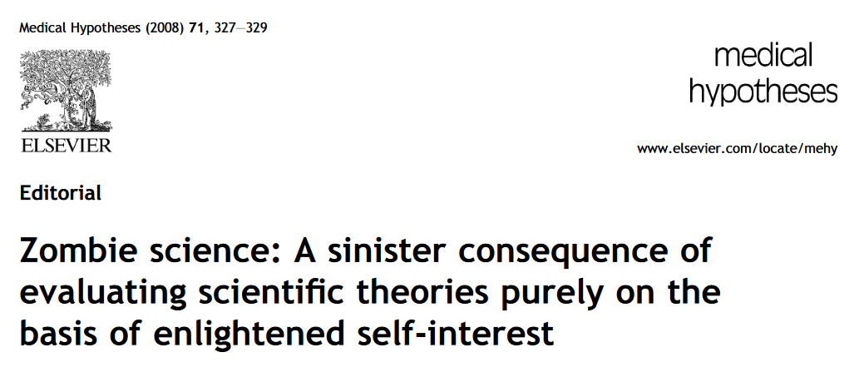





The mantle plume model tries to survive. Probably it is already dead.
Can zombie science be killed?
Notes:
Bogus = not genuine; counterfeit; spurious; sham

Slide 6


...Some people thinks different.
“Geochemistry and chain formation hint that 11 currently active hot spots may be deeply rooted in the mantle.”
Stan Hart, quoted by Kerr, writes: “The major forces are getting older, and none of the young guys are picking it up.” Plume critics aren’t writing peer reviewed papers. I don’t argue with them anymore; it’s a distraction”

Slide 7



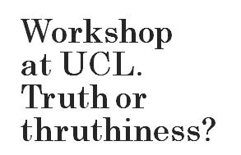


President Trump calls for tripling of plume legacy; riots continue

Slide 8

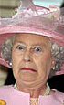


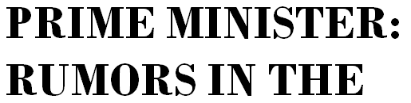




Slide 9
Plumology has become a sort of dogmatic approach to mysterious phenomena.
“It is generally accepted that mantle plumes are…”
“The formation of Large Igneous Provinces (LIPs) is generally attributed to the initial arrival of plumes ”
“These observations [...] form the basis of a popular paradigm that “hotspots” are associated with narrow, thermally driven upwellings or plumes”
“Oceanic basalts (OIB) are the products of mantle plume and hence…”

Slide 10
Unsupported assumptions of the mantle plume concept:
1
Upper mantle (MORB source = asthenosphere) is homogeneous and chemically depleted
2
Tomography measures the temperature of the mantle
3
The Tp of the mantle is ~1300 ºC
4
Geochemistry indicates deep mantle sources for OIB
5
High ³He/⁴He ratios indicate primitive mantle sources
6
High magma production is related to high absolute T
7
Intra-plate magmatism is related to mantle plumes

Slide 11
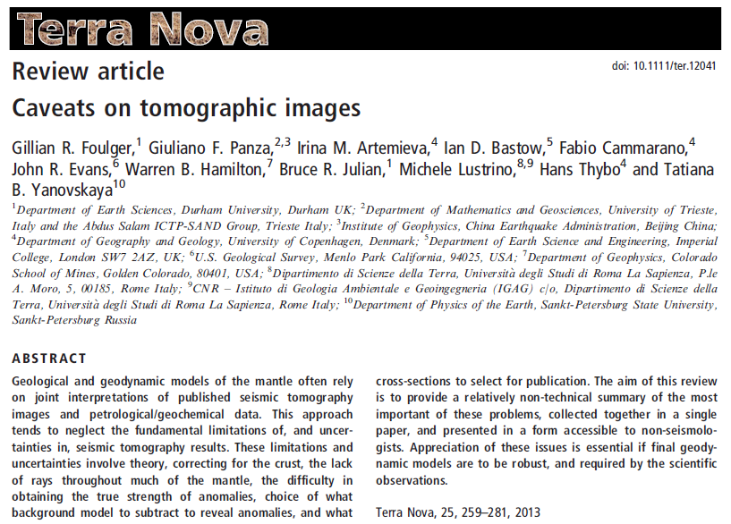
An article on geophysics for petrologists and geochemists

Slide 12
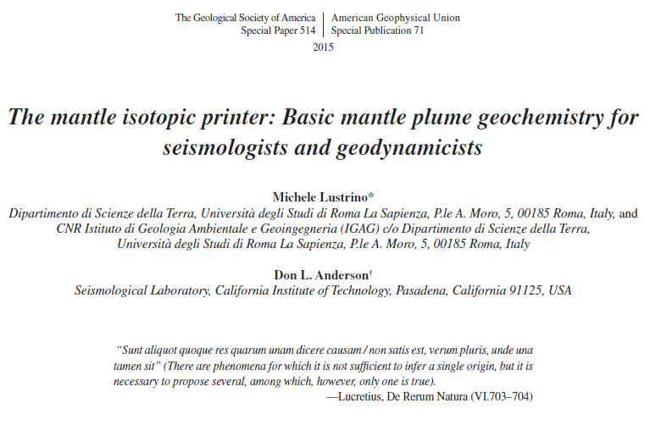
An article on geochemistry and petrology for geophysicists

Slide 13
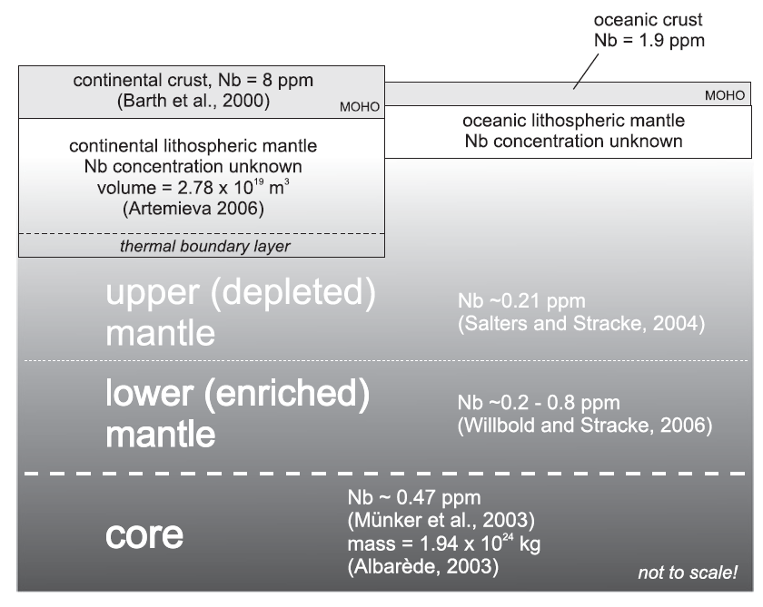
Unsupported assumptions:
1
Upper mantle is:
Homogeneous
Chemically depleted
Classical approach
upper (depleted) mantle
lower (enriched) mantle
From: Pfander et al. (2012), Geochim. Cosmochim. Acta, 77, 232-251

Slide 14
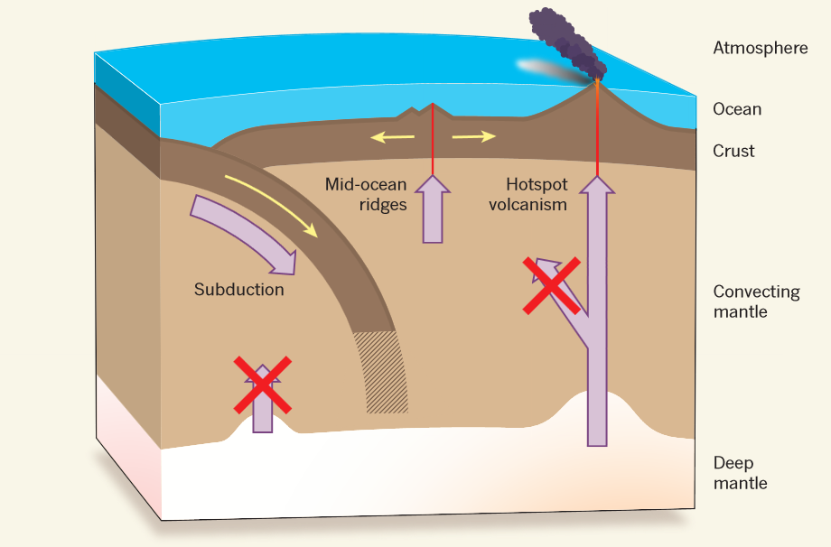
Unsupported assumptions:
“Ocean Island Basalts (OIBs) have a varied isotopic signature that is distinct from that of mid-ocean ridge basalts (MORBs), which are derived from the upper layers of the mantle. […] These differences in the isotopic characteristics have been
explained in terms of the ability of the plume to raise material from very deep in the mantle, often the core-mantle boundary (CMB).”
Cagney et al. (2015), G3, 16, 579-599
Ballentine (2012), Nature, 486, 40-41

Slide 15
DMM
Madeira
BSE
HIMU
Samoa,
Society Islands
St. Helena,
Cook-Austral
EMII
ChUR
Composition of primitive mantle
EMI
Pitcairn, Walvis Ridge

Slide 16
Atlantic MORB
Indian MORB
Pacific MORB

Slide 18
Classical geochemical approach:
HIMU
(St. Helena, Cook-Austral)
EMI
(Pitcairn, Walvis Ridge)
EMII
(Samoa, Society Islands)
“Mantle plumes can be divided into several genera, EMI, EMII and HIMU...”
(White, 2015, Geochem. Perspect., 4, 95-251)
Hypothetical composition of the Upper Mantle.
DMM

Slide 19
Classical geochemical approach:
HIMU
(St. Helena, Cook-Austral)
EMI
(Pitcairn, Walvis Ridge)
EMII
(Samoa, Society Islands)
The most extreme OIB isotopic compositions, but also extremely rare.
“Mantle plumes can be divided into several genera, EMI, EMII and HIMU...”
(White, 2015, Geochem. Perspect., 4, 95-251)
Hypothetical composition of the Upper Mantle.
Not the most common isotopic composition.
DMM
PREvalent MAntle composition.
FOZO

Slide 20
Classical geochemical approach:
St. Helena: Poorest score (very low ³He/⁴He)
HIMU
(St. Helena, Cook-Austral)
EMI
(Pitcairn, Walvis Ridge)
EMII
(Samoa, Society Islands)
The most extreme OIB isotopic compositions, but also extremely rare.
Cook-Austral: No age track (small scale subcontinental Convection)
Pitcairn: Isotopic composition very far away from primitive mantle
Society: Isotopic composition very close to subducted sediments
Fundamental ingredient in the OIB recipe too.
Not the most common isotopic composition.
DMM
Common in oceanic and continental mid-plate.
PREvalent MAntle composition.
FOZO

Slide 21
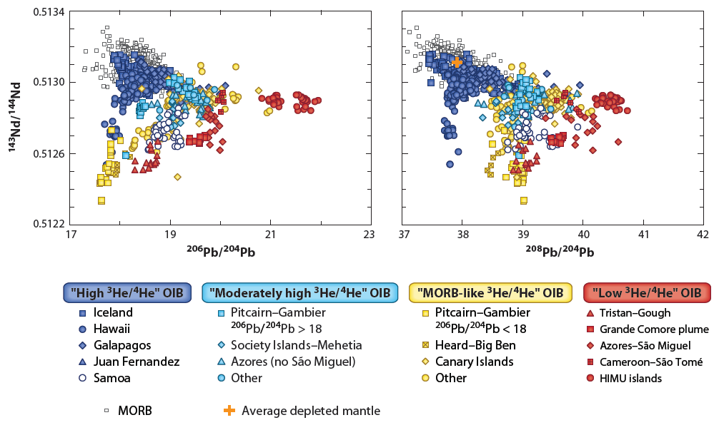
Also from Pb isotopes, the mantle sources of several OIB types are not much different from MORB sources.
MORB
MORB
(Stracke, 2012 Chem. Geol., 330-331, 274-299)
MORB
MORB
(Stracke, 2012 Chem. Geol., 330-331, 274-299)
+
¹⁴³Nd/¹⁴⁴Nd
From: White (2010), Ann. Rev. Earth Planet. Sci., 38, 133-160
²⁰⁶Pb/²⁰⁴Pb
²⁰⁸Pb/²⁰⁴Pb
OIB
+

Slide 22
Also from Pb isotopes, the mantle sources of several OIB types are not much different from MORB sources.
Hawaii archetypal of mantle plumes
MORB
MORB
(Stracke, 2012 Chem. Geol., 330-331, 274-299)
MORB
MORB
(Stracke, 2012 Chem. Geol., 330-331, 274-299)
+
+
“The classical plume theory has indeed successfully predicted first-order observations at many hotspot chains,
¹⁴³Nd/¹⁴⁴Nd
From: White (2010), Ann. Rev. Earth Planet. Sci., 38, 133-160
²⁰⁶Pb/²⁰⁴Pb
²⁰⁸Pb/²⁰⁴Pb
Hawaii being among the most prominent and
best studied examples”.
OIB
Ballmer et al., 2011 (Nature Geosci, 4, 457-460)

Slide 23
Unsupported assumptions:
[…] “The presence in oceanic basalts of a common mantle component that is not the ubiquitous depleted upper mantle (asthenosphere) of mid-ocean ridge basalts (MORB) is probably one of the major findings of igneous isotope geochemistry” Cadoux et al. (2007), EPSL, 259, 227-238
[…] “Geophysical evidence and numerical models of mantle stirring imply the source of mid-ocean ridge basalts (MORBs) comprises most of the mantle, excepting only the D” region and the ‘‘superpile’’ anomalies deep under Africa and the Pacific.” Davies (2009) G3, 10.1029/2009GC002634
[...] “We model two mantle reservoirs corresponding in mass to the Earth’s upper mantle (MORB source) and lower mantle (OIB source), respectively.” Gonnermann and Mukhopadhyay (2009) Nature, 459, 560-563
[…] “Most of the upper mantle materials are the residuals of a small degree of partial melting at ~410-km and hence is nearly homogenous and modestly depleted” Karato (2012), EPSL, 321-322, 95-103
[…] “The geochemical signature of Ocean Island Basalts (OIBs), which are generally attributed to the presence of a mantle plume, is distinct from that of Mid-Ocean Ridge Basalts (MORBs) which are derived from the depleted upper mantle” Cagney and Litghow-Bertelloni (2016) Geophys. J. Int., 205, 1574-1588

Slide 24
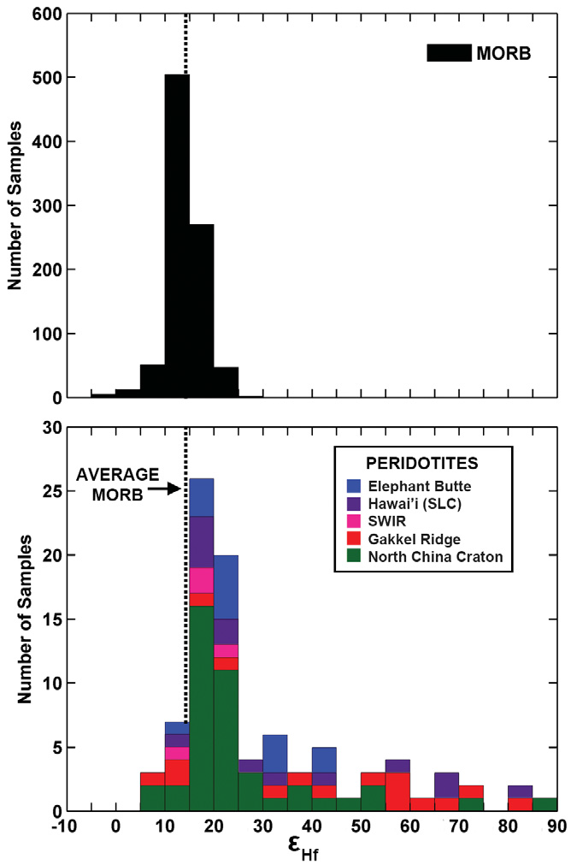
OIB
ε_{Hf} (¹⁷⁶Hf/¹⁷⁷Hf) is roughly correlated to the amount of melt extraction
OIB
average
MORB
average
OIB are as isotopically depleted as MORB
Composition of hypothetical primitive lower mantle
Chondrite (Primitive Earth)
(Down to -30)
Enriched sources
Depleted sources
(Continental Crust)
Byerly and Lassiter, 2014 (Geology, 42, 203-206)

Slide 25
OIB
Upper mantle rocks are much more depleted than MORB (higher εHf)
OIB
average
MORB
average
Chondrite (Primitive Earth)
MORB
Enriched sources
Depleted sources
(Continental Crust)
Byerly and Lassiter, 2014 (Geology, 42, 203-206)

Slide 26
OIB
1) OIB and MORB are isotopically similar;
2) Upper mantle is not fully convecting;
3) MORB sources contain enriched lithologies.
OIB
average
MORB
average
MORB

Slide 27
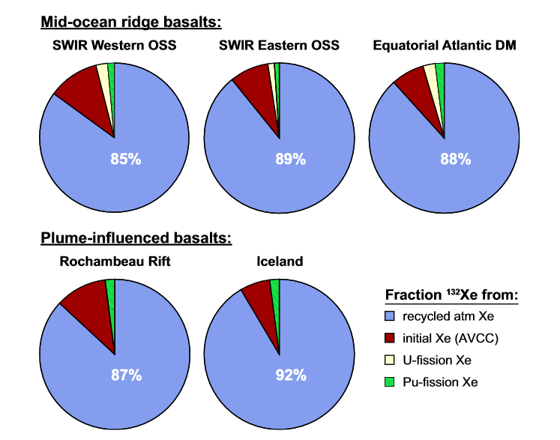
Unsupported assumptions:
1
Upper mantle is:
Homogeneous
Chemically depleted
Recycled atmospheric Xe uniformly dominates the mantle Xe budget (percentages given in white).
MORB and Plume sources nearly identical in terms of Xe isotopic budget.
Parai and Mukhopashyay (2015), G3, 16, 719-735

Slide 28
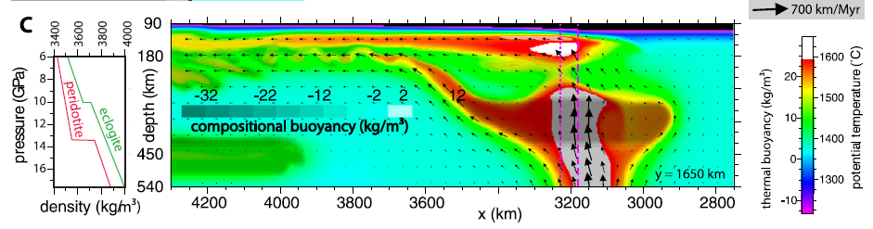
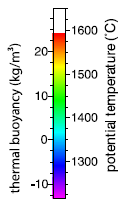
Unsupported assumptions:
From Thermal to Thermochemical Plumes
Ballmer et al., 2013 (EPSL, 376, 155-164)
But upper mantle is still considered to be homogeneous, 300 K colder than lower mantle Tp, and not prone to partially melt.
Heterogeneities confined to mantle plume sources.

Slide 29
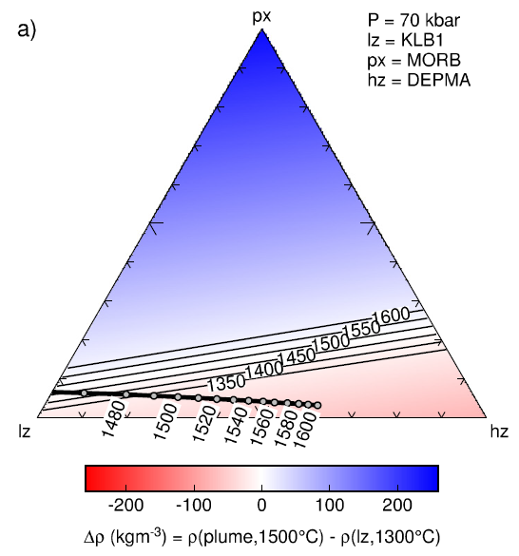
Unsupported assumptions:
From Thermal to Thermochemical Plumes
“Only lithology mixtures incorporating a significant harzburgite component are able to reproduce recent estimates of the Iceland plume’s volume flux”.
“Low density refractory harzburgite
is a more ubiquitous component
in mantle plumes than previously acknowledged”.
Pxite
Tp of neutrally buoyant plumes
Lherz
Harz
Shorttle et al. (2014) EPSL, 395, 24-40

Slide 30
Unsupported assumptions:
Thermodynamic Recipe for a Iceland’s Plume:
30-60% depleted mantle (harzburgite);
5-10% pyroxenite/eclogite/garnetite;
Pxite
35-90% hydrous lherzolite
The higher the T the higher the % of harzburgite.
Tp of neutrally buoyant plumes
(to limit the thickness of the produced basaltic crust to ~20 km)
Lherz
Harz
Shorttle et al. (2014) EPSL, 395, 24-40
Notes:
On geochemical grounds the amount of melts derived from pyroxenite is calculated by the authors to 30% ±10%.
This equals to an amount of pyroxenite in the Iceland mantle source to 5-15% (due to the much lower solidus of pyroxenite compared to lherzolite).
In this model harzburgite is assumed never be able to partially melt.

Slide 31
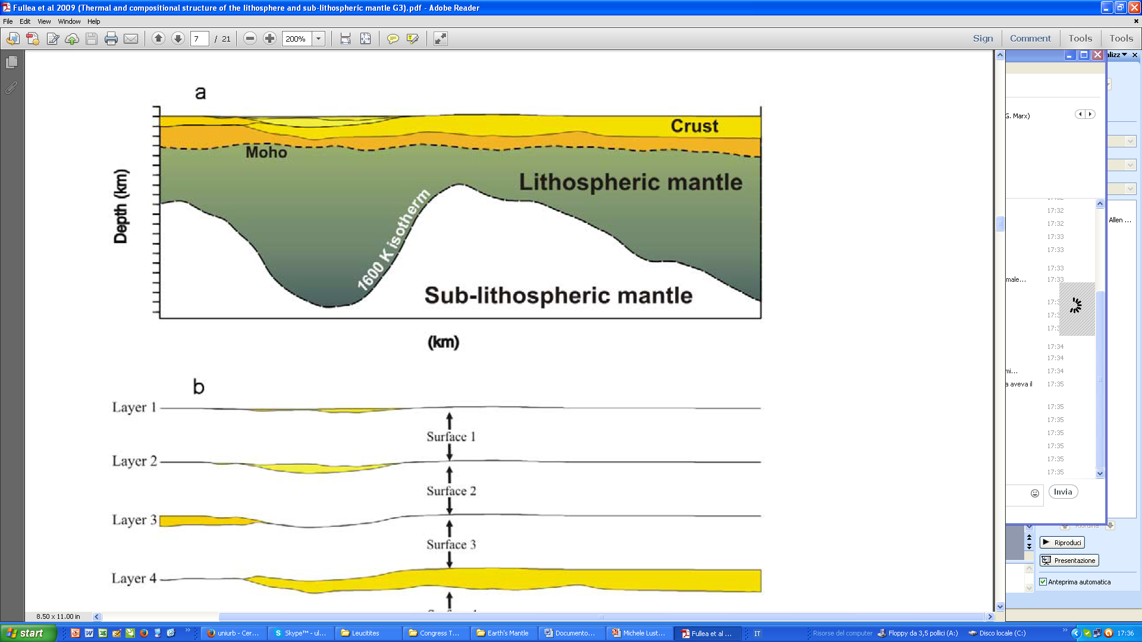
Unsupported assumptions:
The term “Asthenosphere” is used loosely.
Is asthenosphere...
An Isotherm?
Fullea et al. (2009), G3, doi:10.1029/2009GC002391

Slide 32
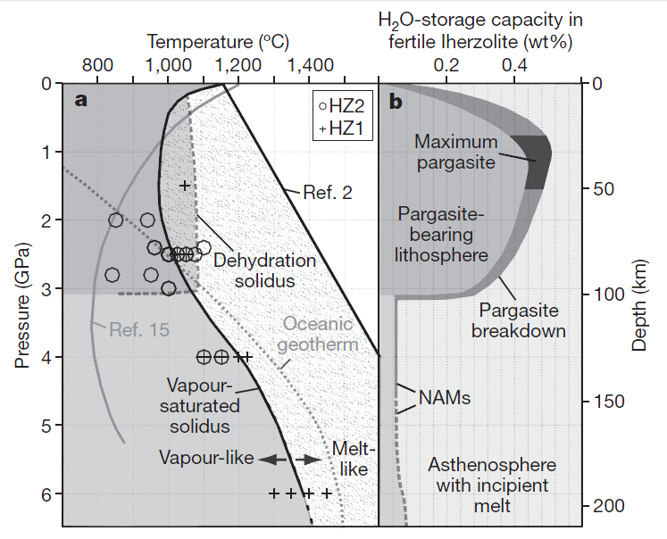
Unsupported assumptions:
The term “Asthenosphere” is used loosely.
Is asthenosphere...
An Isotherm?
An Isobar?
Lithosphere-Asthenosphere Boundary
Not an isotherm, but an isobar
Green et al. (2010) Nature, 467, 448-451

Slide 33
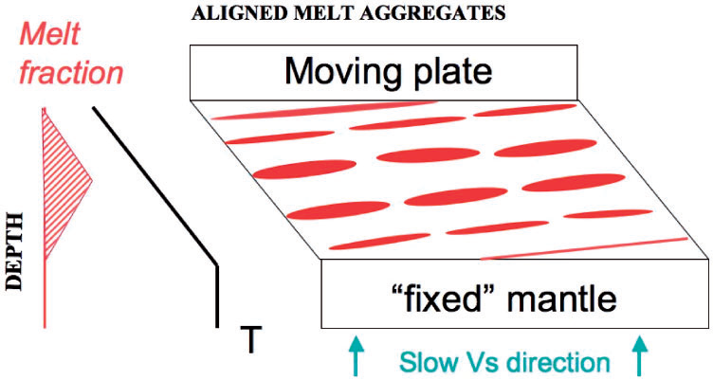
Unsupported assumptions:
The term “Asthenosphere” is used loosely.
Is asthenosphere...
Fully convecting?
An Isobar?
Anderson (2011) J. Petrol., 52, 1547-1577
Upper Boundary Layer
50-120 km
Conductive Layer
Classically defined “Asthenosphere”
B Region of Gutenberg (1959)
Layer of Laterally Advecting Mass and Anisotropy
“Fixed (convecting)” Mantle
Melt Fraction

Slide 34
Unsupported assumptions:
The term “Asthenosphere” is used loosely.
Is asthenosphere...
Fully convecting?
Smith (2015) AGU-GSA Spec. Paper 514, 305-324

Slide 35
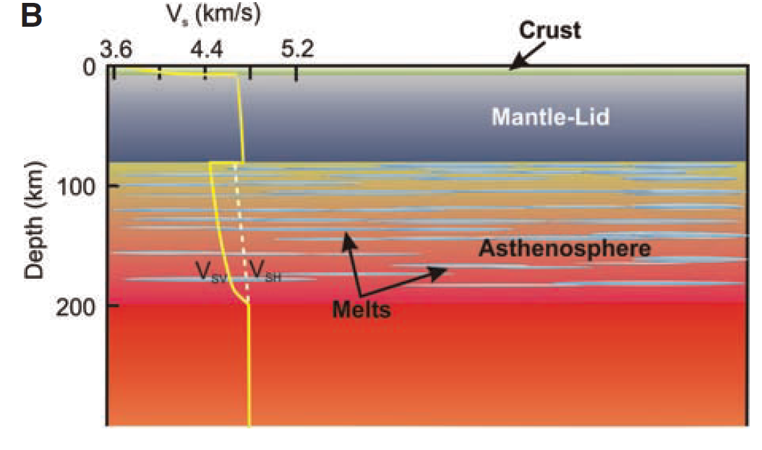
Unsupported assumptions:
The term “Asthenosphere” is used loosely.
Is asthenosphere...
Fully convecting?
± the same as LLAMA
Kawakatsu et al. (2009) Science, 324, 499-502

Slide 36
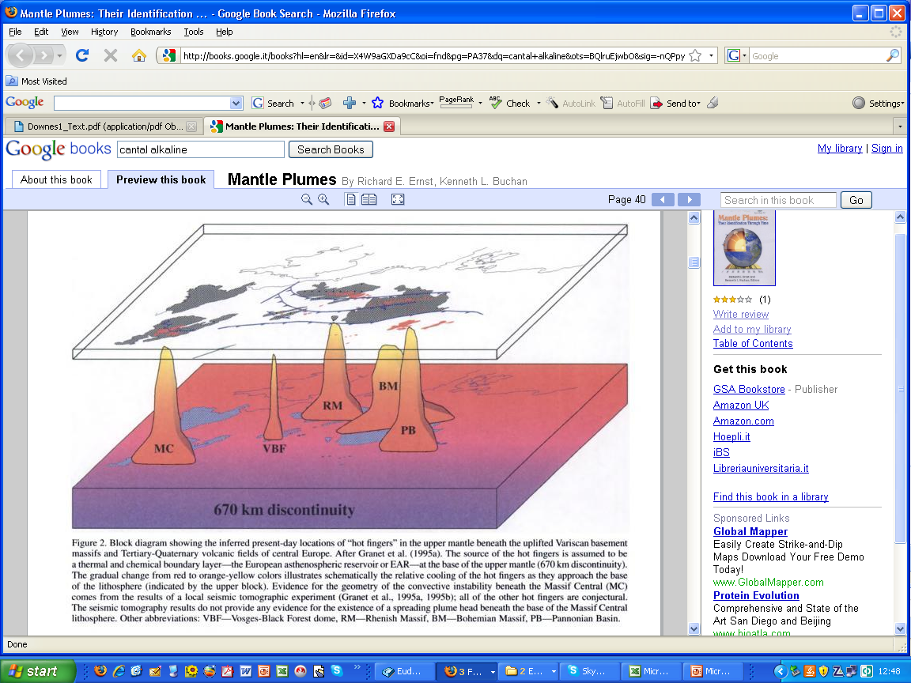
Unsupported assumptions:
The term “Asthenosphere” is used loosely.
Is asthenosphere...
Extending down to the base of the TZ?
Fully convecting?
EAR
European Asthenospheric Reservoir
Rhenish Massif
Bohemian Massif
Vosges Black Forest
Pannonian Basin
Massif Central
Wilson and Patterson (2001) Geol. Soc. Am. Spec. Paper,352, 37-58
EAR

Slide 37
Unsupported assumptions:
2
Tomography can be used to measure the temperature of the mantle
“Between the depths of 100 and 250 km, the velocity anomalies are approximately 2–2.5% slower than average, implying a temperature excess of about 220–280 K, which is consistent with estimates for other mantle plumes.” Macera et al. (2003) J. Geodyn., 36, 563-590
“[…] Negative (positive) wave speed anomalies likely represent predominantly higher (lower) temperatures than average. Temperature anomalies can be as large as 10%-20%.” Spakman and Wortel (2004) Transmed Atlas, 31-52
“Mineral physics predicts that slow seismic anomalies in the mantle are most likely due to high temperatures, so we expect slow seismic wave speeds to be a signature of mantle plumes. ” Jenkins et al. (2016) EPSL, 433, 159-168

Slide 38
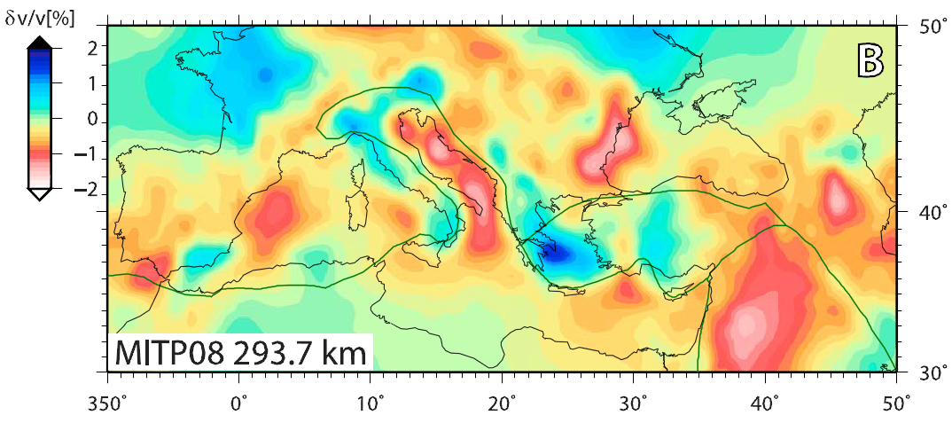
Unsupported assumptions:
2
Tomography can be used to measure the temperature of the mantle
Does “Red” mean “Hot”?
(0.02 Ma)
No magmatism
(1 Ma)
No magmatism
(Afar)
No magmatism
No magmatism
P-wave
Boschi et al. (2010) Geophys. Res. Lett., 37, doi:10.1029/2010GL045001

Slide 39
Unsupported assumptions:
2
Tomography can be used to measure the temperature of the mantle
Cenozoic igneous activity with “plume” geochemical features
Boschi et al. (2010) Geophys. Res. Lett., 37, doi:10.1029/2010GL045001

Slide 40
Unsupported assumptions:
2
Tomography can be used to measure the temperature of the mantle
Vosges-
Black Forest
Pannonian Basin
French Massif Central
Mt. Etna
Where are the mantle plume traces of...
P-wave
Boschi et al. (2010) Geophys. Res. Lett., 37, doi:10.1029/2010GL045001

Slide 41
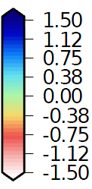
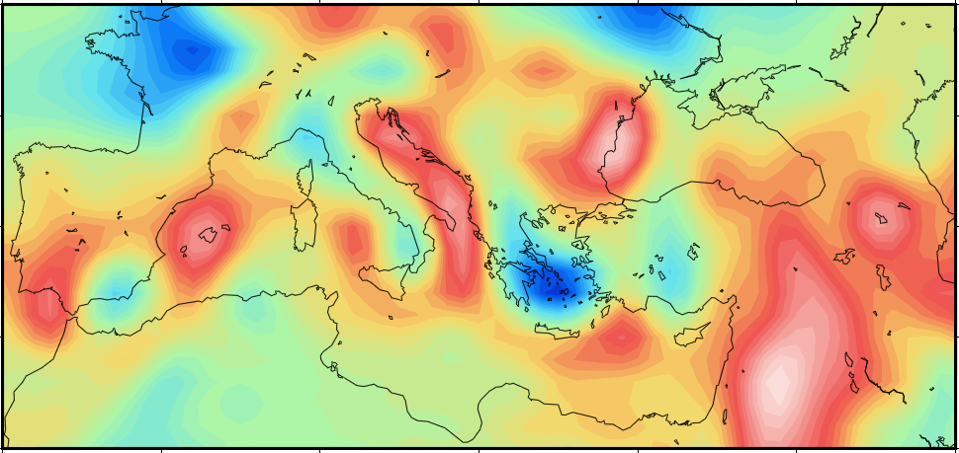
Unsupported assumptions:
2
Tomography can be used to measure the temperature of the mantle
P-wave
P-wave
Li et al. (2008) G3, 9, Q05018, doi:10.1029/2007GC001806

Slide 42
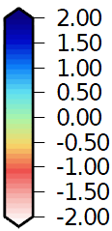
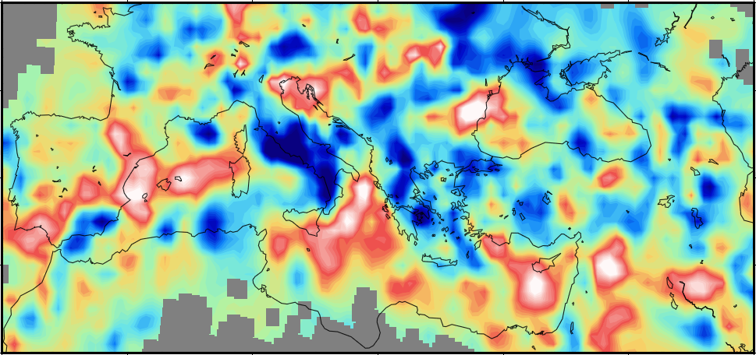
Unsupported assumptions:
2
Tomography can be used to measure the temperature of the mantle
P-wave
300 km
P-wave
Piromallo and Morelli (2003) J. Geophys. Res., 108, B02 165, doi:10.1029/2002JB001757

Slide 43
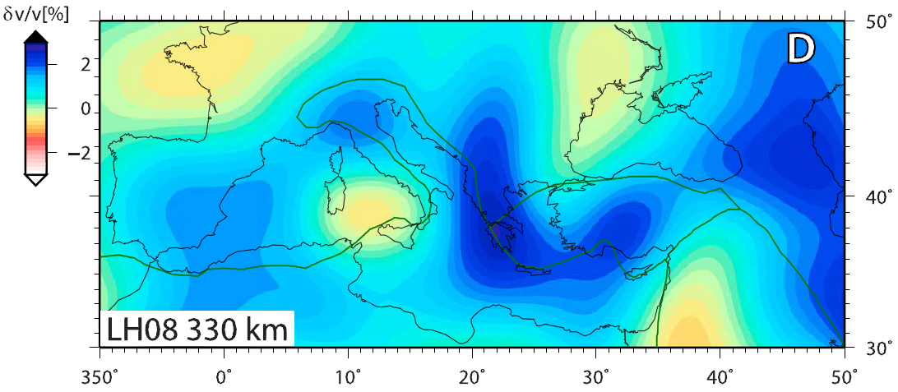
Unsupported assumptions:
2
Tomography can be used to measure the temperature of the mantle
δv/v >+3%
δv/v ~0%
P-wave
300 km
S-wave
Becker and Boschi (2002) Geochem. Geophys. Geosyst., 3, doi:10.1029/2001GC000168

Slide 44
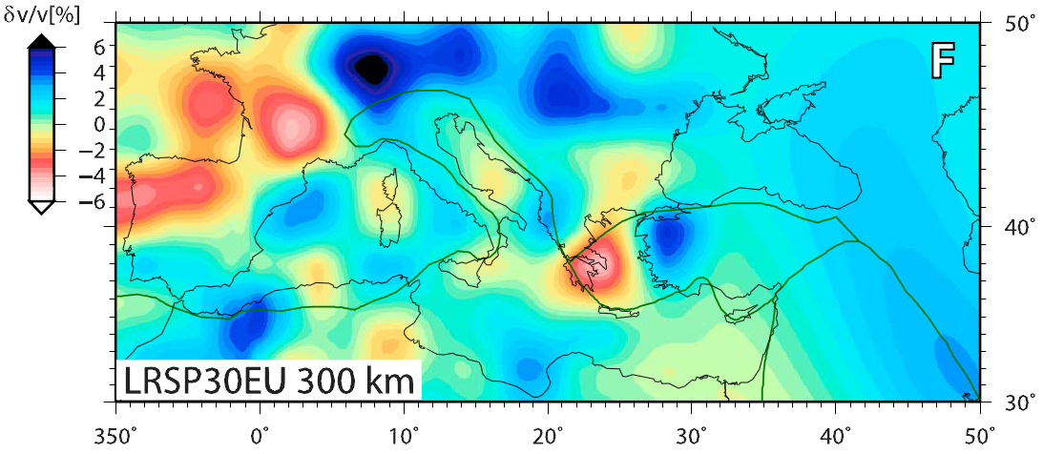
Unsupported assumptions:
2
Tomography can be used to measure the temperature of the mantle
δv/v <-4%
δv/v <-4%
S-wave
Boschi et al. (2009) Surv. Geophys., 30, 463–501

Slide 45
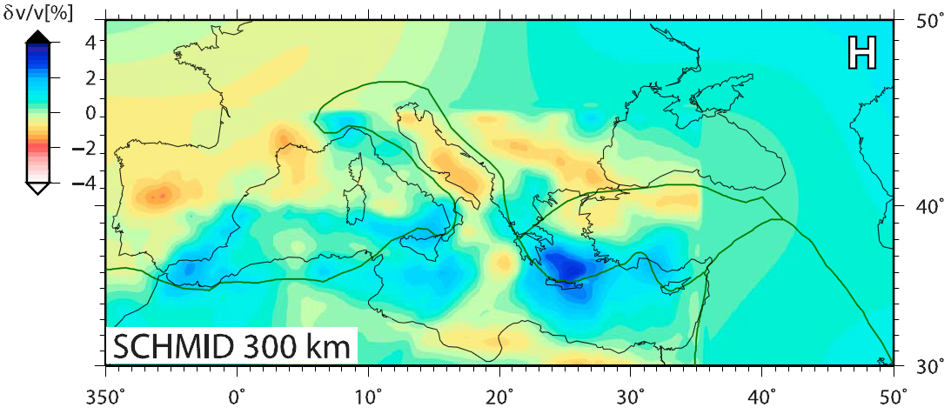
Unsupported assumptions:
2
Tomography can be used to measure the temperature of the mantle
δv/v ~+1%
δv/v ~0%
S-wave
S-wave
Schmid et al. (2008) J. Geophys. Res., 113, B03306, doi:10.1029/2005JB004193

Slide 46
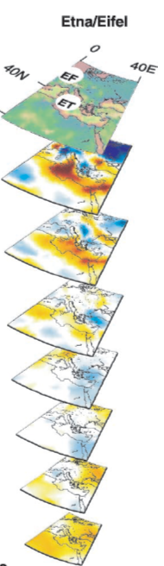
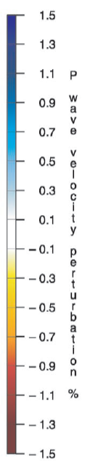
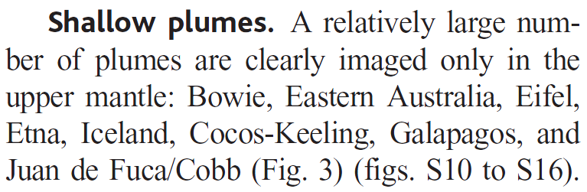

Montelli et al. (2004) Science, 303, 338-343
Mt. Etna
Boschi et al. (2010) Geophys. Res. Lett., 37, doi:10.1029/2010GL045001

Slide 47
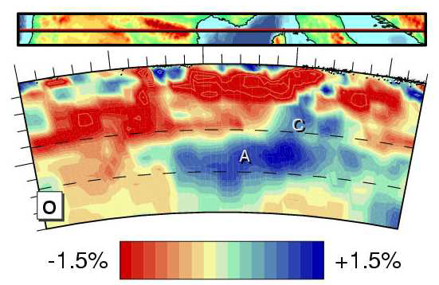
Montelli et al. (2004) Science, 303, 338-343
300 km
Spakman and Wortel (2004) Transmed Atlas, 31-52
…A mantle plume channeled from N Atlantic and passing beneath Iberia, Pyrenees, Ligurian-Provençal Basin up to N Tyrrhenian Sea?

Slide 48
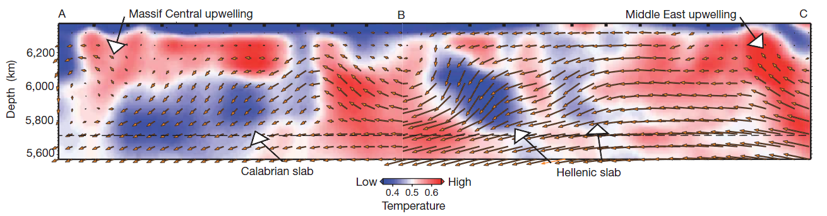
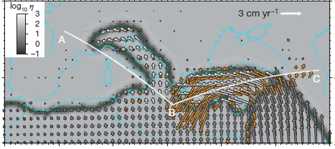
Ionian upwelling?
Massif Central Plume
Afar Plume
Ionian Plume?
>400 km thick
Mantle Plume trace in a collisional setting
Faccenna and Becker (2010) Nature, 465, 602-605
[…] “assuming that velocity anomalies are simply related to temperature”.
No igneous activity in the last 220 Myr
Faccenna and Becker (2010) Nature, 465, 602-605
But: […] Seismic velocities depend not only on temperature and pressure, but compositional variations may contribute significantly in the upper mantle. Giacomuzzi et al. (2012) EPSL, 335-336, 105-120

Slide 49
Unsupported assumptions:
2
Tomography can be used to measure the temperature of the mantle
Seismology has simply no more power to map hot plumes than geochemistry
(…and geochemistry has none...)

Slide 50
Unsupported assumptions:
3
The Tp of the mantle at the base of the Plate (~100 km) and for the whole upper mantle is ~1300 ºC.
Four main approaches adopted by geoscientists:
“Normal” adiabatic mantle Tp (e.g. MORB source) is constant (~1300 ºC). Magmas formed at higher temperatures (e.g. OIB) come from hotter (deeper) sources.
“Normal” midplate (OIB) mantle Tp is ~1500 ºC. Magmas formed at lower T (e.g., MORB) come from colder sources.
There is no difference between OIB and MORB Tp.
It is not possible to define “normal” Tp because the Earth’s interior is not adiabatic. No correlation between Tp and depth of magma source.

Slide 51
Unsupported assumptions:
3
The Tp of the mantle at the base of the Plate (~100 km) and for the whole upper mantle is ~1300 ºC.
“Normal” adiabatic mantle Tp (e.g. MORB source) is constant (~1300 ºC). Magmas formed at higher temperatures (e.g. OIB) come from hotter (deeper) sources.
“A Tp of ~1550 ºC is required for the production of Hawaiian magmas […], and >1600 ºC for Gorgona picrites. The excess temperature […] is typically about 200–300 ºC”.
Herzberg et al. (2007) G3, 10.1029/2006GC001390
“…Geochemistry provides convincing evidence that mantle plumes are 100–300 ºC hotter than normal upper mantle”
White (2010) Ann. Rev. Earth Planet. Sci. 38, 133-160

Slide 52
Unsupported assumptions:
3
The Tp of the mantle at the base of the Plate (~100 km) and for the whole upper mantle is ~1300 ºC.
Temperature (°C)
1000
2000
3000
4000
0
This is the classical approach used by geochemists and petrologists.
Based on McKenzie and Bickle (1988).
Hypothetical Mantle Plume Tp
Hypothetical Ambient Mantle Tp
1000
Depth (km)
~0.6 K/km
~0.6 K/km
2000
Classically accepted Geotherm (e.g., Hassan et al., 2015)
3000
Notes:
52

Slide 53
Unsupported assumptions:
3
The Tp of the mantle at the base of the Plate (~100 km) and for the whole upper mantle is ~1300 ºC.
2) “Normal” midplate (OIB) mantle Tp is ~1500 ºC. Magmas formed at lower T (e.g., MORB) come from colder sources.
The deep (>10 GPa) Tp of MORB and OIB source is the same.
The Tp of the two type of magmas is different because of a thermal cooling under MOR caused by thinner lithosphere and heat transfer via magma.
Presnall and Gudfinnsonn (2011) J. Petrol., 52, 1533-1546

Slide 54
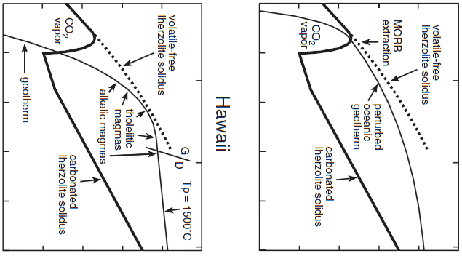
Unsupported assumptions:
3
The Tp of the mantle at the base of the Plate (~100 km) and for the whole upper mantle is ~1300 ºC.
Temperature (°C)
Temperature (°C)
1350-1500 °C
~1280 °C
800
1000
1200
1400
1600
1800
800
1000
1200
1400
1600
1800
Tp range of Hawaiian Lavas
Typical Tp of MORB
0
Typical MORB extraction depth
Dry Peridotite Solidus
2
Dry Peridotite Solidus
Estimated depth of extraction of Hawaiian lavas
Perturbed oceanic geotherm
4
Pressure (GPa)
Hawaii
MORB
6
8
The same Tp at P ~10 GPa
Presnall and Gudfinnsson (2011) J. Petrol., 52, 1533-1546
10

Slide 55
Unsupported assumptions:
3
The Tp of the mantle at the base of the Plate (~100 km) and for the whole upper mantle is ~1300 ºC.
3) There is no difference between OIB and MORB Tp.
The geothermometric results for the Hawaiian picrites indicate liquidus temperature ~1315 ºC
The geothermometric results for the MORB picrites indicate liquidus temperature ~1325 ºC
Green et al. (2001) Eur. J. Mineral., 13, 437-451

Slide 56
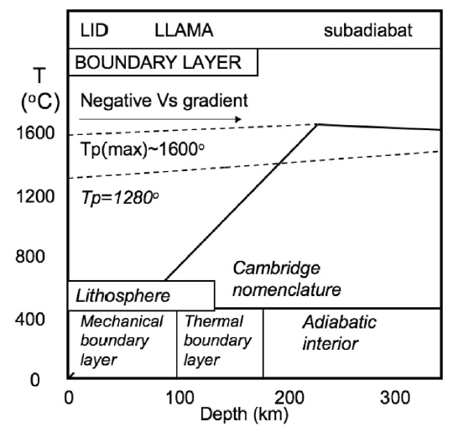
Unsupported assumptions:
3
The Tp of the mantle at the base of the Plate (~100 km) and for the whole upper mantle is ~1300 ºC.
4) It is not possible to define “normal” Tp because the Earth’s interior is not adiabatic.
No correlation between Tp and depth of magma source.
“Over most of the mantle the geotherm is subadiabatic, meaning that Tp in D’’ can be less than in the upper Mantle”.
Anderson (2011) J. Petrol., 52, 1547-1577
Notes:
56

Slide 57
Unsupported assumptions:
3
The Tp of the mantle at the base of the Plate (~100 km) and for the whole upper mantle is ~1300 ºC.
Temperature (ºC)
1000
2000
3000
4000
“Classical view”
0
MORB source is shallow (because cold)
1000
Depth (km)
OIB source is very deep (because hotter than ambient mantle)
2000
3000
Notes:
57

Slide 58
Unsupported assumptions:
3
The Tp of the mantle at the base of the Plate (~100 km) and for the whole upper mantle is ~1300 ºC.
Temperature (ºC)
1000
2000
3000
4000
Alternative geotherms
0
0
Tackley et al. (1993)
King (2015)
Nakagawa et al. (2015)
Hoink and Lenardic (2008; thin asthenosphere)
1000
Zhong and Rudolph (2015)
Moore (2008; internal heating)
The Tp of the shallow mantle is higher than that of the deepest mantle.
Depth (km)
Moore (2008; no internal heating)
Hoink and Lenardic (2008; thick asthenosphere)
2000
Schuberth et al. (2009)
Sinha and Butler (2007; internal heating)
Sinha and Butler (2007; no internal heating)
3000
Notes:
58

Slide 59
Unsupported assumptions:
3
The Tp of the mantle at the base of the Plate (~100 km) and for the whole upper mantle is ~1300 ºC.
Temperature (ºC)
1000
2000
3000
4000
MORB source remains cold (but is also deep)
0
0
TZ
Tackley et al. (1993)
King (2015)
Nakagawa et al. (2015)
Hoink and Lenardic (2008; thin asthenosphere)
OIB source is hot
1000
Zhong and Rudolph (2015)
(but is also shallow)
Moore (2008; internal heating)
Depth (km)
Moore (2008; no internal heating)
Hoink and Lenardic (2008; thick asthenosphere)
No involvement of deep mantle material
2000
Schuberth et al. (2009)
Sinha and Butler (2007; internal heating)
Sinha and Butler (2007; no internal heating)
3000
Notes:
59

Slide 60
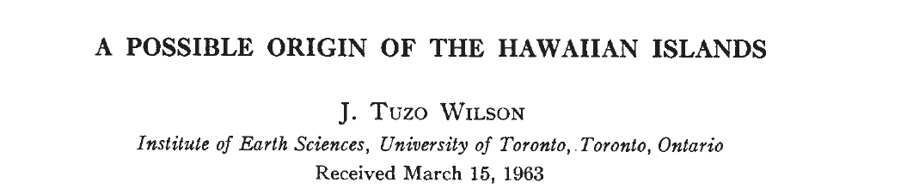
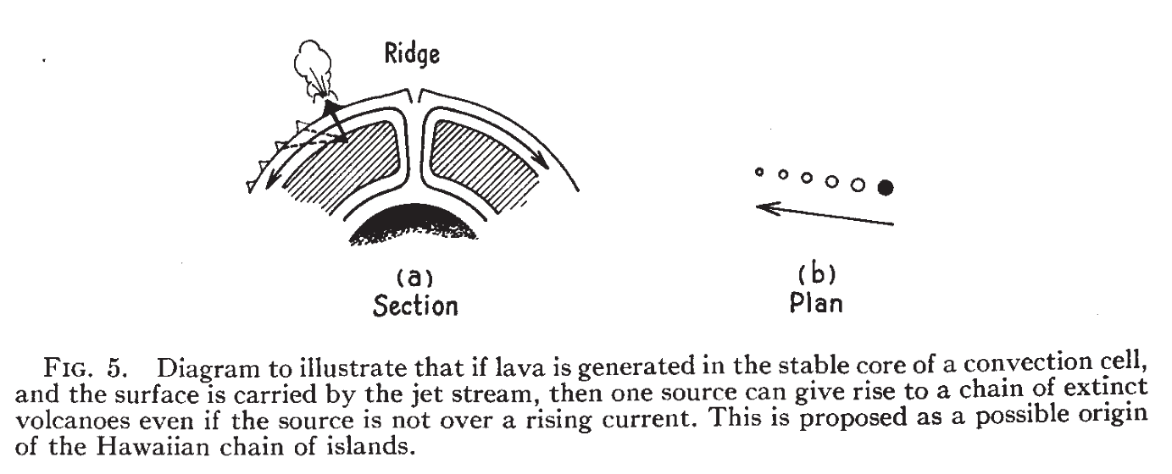
Unsupported assumptions:
3
The Tp of the mantle at the base of the Plate (~100 km) and for the whole upper mantle is ~1300 ºC.
shallow
OIB
Shallow source
(~200 km depth)
Wilson (1963)
Can. J. Phys., 41, 863-870
MORB
Deep source
Notes:
60

Slide 61
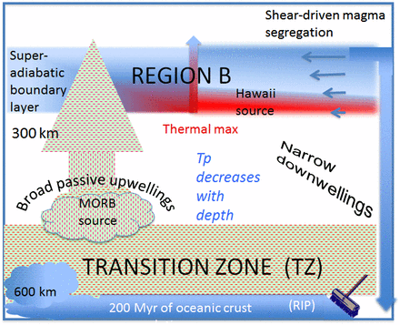
Unsupported assumptions:
3
The Tp of the mantle at the base of the Plate (~100 km) and for the whole upper mantle is ~1300 ºC.
“New” paradigm:
MORB source is deep
OIB source is shallow
Anderson and Natland (2014) Proc. Natl. Acad. Sci. 111, E4298-E4304
Notes:
61

Slide 62
Unsupported assumptions:
4
Geochemistry clearly indicates provenance of OIB from the deep mantle.
Much is based on the original model of crustal recycling by A.W. Hofmann and S. Hart.
“We adopt Morgan's hypothesis [deep mantle origin for OIB] because [...] no viable alternative model has been proposed that would explain the kinematic and geochemical peculiarities of "hot-spot“ volcanism”
Hofmann and White (1982) EPSL, 57, 421-436 (>1200 quotations)

Slide 63
Unsupported assumptions:
4
Geochemistry clearly indicates provenance of OIB from the deep mantle.
“Mantle plumes are physical features, and they might be identified geochemically if they are either derived from, or entrain material that has a distinctive geochemical fingerprint”.
Hawkesworth and Schersten (2007) Chem. Geol., 241, 319-331
“We suspect that geochemistry will not deliver the silver bullet for proving or disproving plumes.”.
Hofmann and Hart (2007) Science, 315, 40
“most geochemical tracers carry no information about the specific mantle depth being sampled”; “geochemistry cannot prove mantle plumes”.
Hofmann (2014) AGU Fall meeting V23G-01

Slide 64
Unsupported assumptions:
5
High ³He/⁴He ratios in basaltic melts indicate undegassed (primitive) mantle sources (= deep mantle).
Extremely high ³He/⁴He ratios in some ocean-island basalts suggest the presence of relatively undegassed and undifferentiated material preserved in Earth’s mantle. Jackson et al. (2010) Nature, 466, 853-856
The most reasonable mechanism to account for the elevated ³He/⁴He is a plume derived from the deep mantle. Camp (2013) GGA Spec. P. 497, 181-199
High ³He/⁴He ratios in some OIBs indicate the existence of relatively undegassed regions in the deep mantle Hallis et al. (2014) Science, 350, 795-797
He isotopes provide direct evidence for the preservation of relatively undegassed, primordial reservoirs in the present-day mantle Peters and Day 2014, G3 DOI 10.1002/2014GC005506
Many plumes also contain a quite primitive component, manifested primarily in their noble gas isotope ratios. White (2015) Geochem. P,, 2, 95-265
Deep, dense high-³He/⁴He domain will be preferentially entrained by the hottest, most buoyant mantle plumes. Jackson et al. (2017) Nature, 542, 340-343

Slide 65
Unsupported assumptions:
5
High ³He/⁴He ratios in basaltic melts indicate undegassed (primitive) mantle sources (= deep mantle).
“The existence of different ⁴He/³He ratios underpins the idea that there are at least two geochemical reservoirs
in the mantle: a deep reservoir rich in gases and volatile compounds feeds material into an upper reservoir, which is the convecting part of the mantle that supplies magma to mid-ocean ridges”
Low ³He
Gas-poor source
Gas-rich source
High ³He
Ballentine (2012) Nature, 486, 40-41

Slide 66
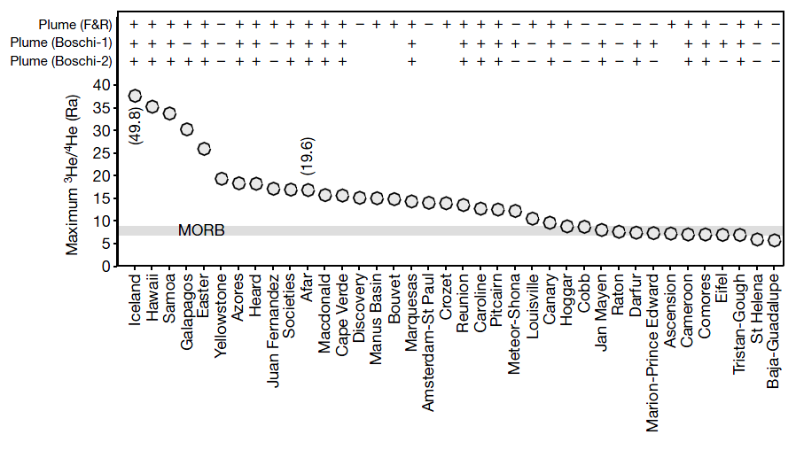
Unsupported assumptions:
5
High ³He/⁴He ratios in basaltic melts indicate undegassed (primitive) mantle sources (= deep mantle).
Iceland #1
“Dense high-³He/⁴He domain will be preferentially entrained by the hottest, most buoyant mantle plumes.”
³He/⁴He 6-37
High ³He/⁴He = High T
Jackson et al. (2017) Nature, 542, 340-343

Slide 67
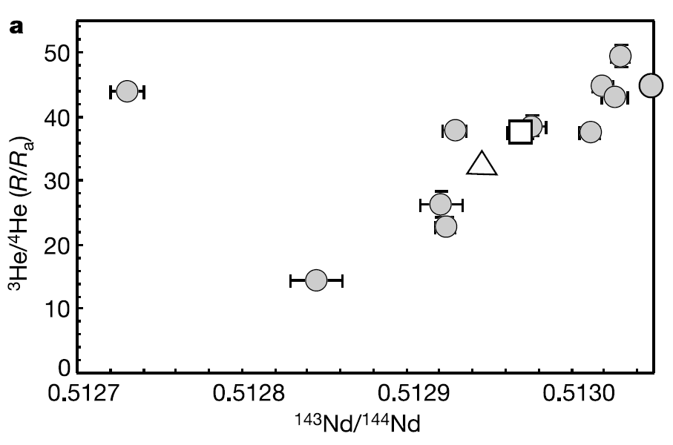
Unsupported assumptions:
5
High ³He/⁴He ratios in basaltic melts indicate undegassed (primitive) mantle sources (= deep mantle).
The highest the ³He/⁴He, the highest the ¹⁴³Nd/¹⁴⁴Nd
Baffin Island (Iceland proto-plume) picrites
High ¹⁴³Nd/¹⁴⁴Nd is at odd with a primitive or undegassed mantle source.
Stuart et al. (2003) Nature, 424, 57-59
MORB range:
(¹⁴³Nd/¹⁴⁴Nd = 0.5128-0.5133)
(⁸⁷Sr/⁸⁶Sr = 0.7030-0.7039)

Slide 68
Unsupported assumptions:
Do you remember these diagrams?
MORB
High ³He/⁴He OIB = MORB-like
MORB
High ³He/⁴He OIB = MORB-like
¹⁴³Nd/¹⁴⁴Nd
Low (MORB-like) ³He/⁴He OIB = MORB-different
Low (MORB-like) ³He/⁴He OIB = MORB-different
White (2010) Ann. Rev. Earth Planet. Sci., 38, 133-160
²⁰⁶Pb/²⁰⁴Pb
²⁰⁸Pb/²⁰⁴Pb
OIB

Slide 69
Unsupported assumptions:
5
High ³He/⁴He ratios in basaltic melts indicate undegassed (primitive) mantle sources (= deep mantle).
MORB have statistically higher ³He and ⁴He than OIB

Slide 70
Unsupported assumptions:
5
High ³He/⁴He ratios in basaltic melts indicate undegassed (primitive) mantle sources (= deep mantle).
MORB have statistically higher ³He but lower ³He/⁴He than OIB

Slide 71
Concluding remarks:
- Do not believe geochemists blindly or geophysicists or petrologists.
- OIB geochemistry does nor require deep mantle upwelling.
- OIB geochemistry requires interaction with non-peridotitic lithologies.
- Sub-lithospheric mantle is not fully convecting nor chemically homogeneous.
Red does not mean hot in tomography.
The Tp of ambient mantle is likely >1300 ºC
Upper mantle can explain the origin of OIB (and of continental mid-plate magmas).
MORB sources can be deeper and colder than OIB

Slide 72
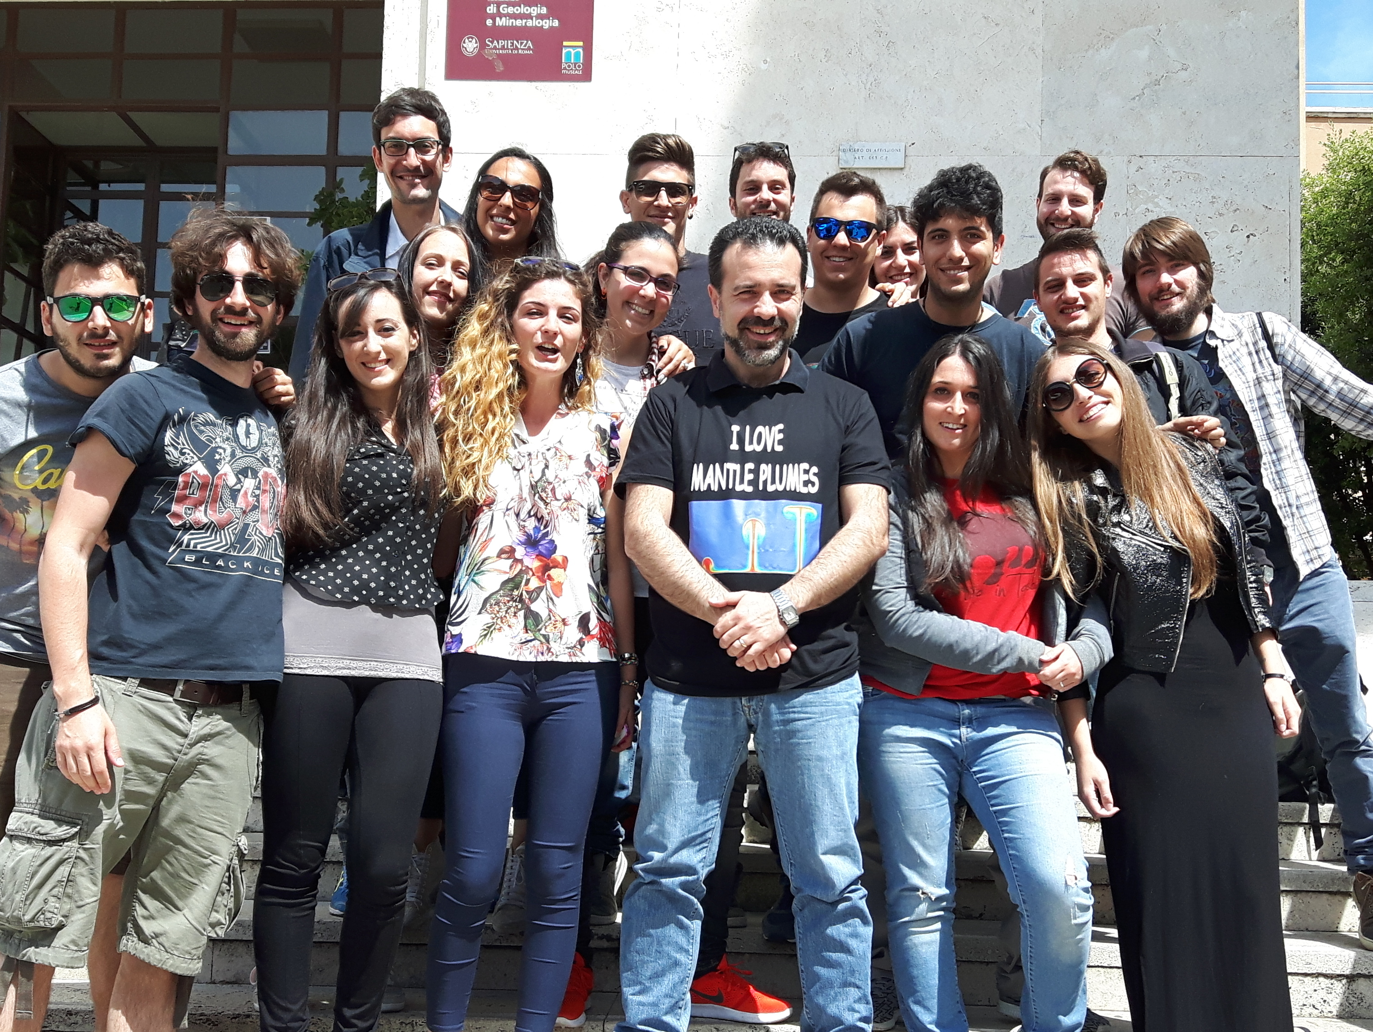
Thanks for the attention
A copy of this presentation can be found at:
www.mantleplumes.org

